Slide 1
Incorporating Aboriginal and Torres Strait Islander Histories and Cultures into the curriculum.
_{Copyright Christine Reid}
Notes:
This series of slides provides an insight into the Aboriginal and Torres Strait Islander Histories and Cultures, cross curriculum priority of the Australian Curriculum. The subject areas provide teaching ideas and resource links.
Photography, copyright Christine Reid

Slide 2
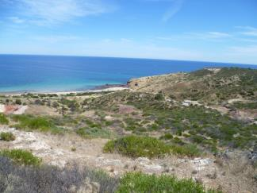
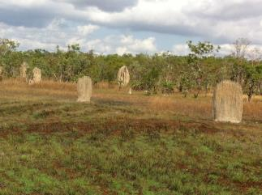
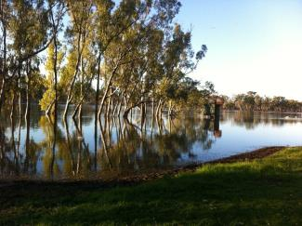
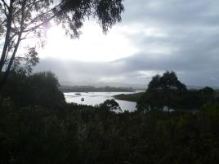
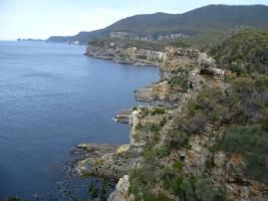
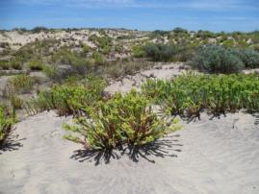
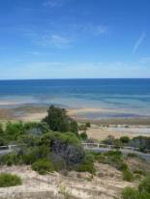
We acknowledge that we are meeting on the traditional country of the Aboriginal and Torres Strait Islander Australian people.
We recognise and respect their cultural heritage, beliefs and relationship with the land. We acknowledge that they are of continuing importance to the Aboriginal and Torres Strait Islander Australian people living today.
_{Copyright Christine Reid}
Notes:
Acknowledgement of country
Acknowledgement of country is the privilege of all Australians. It is given by any Australian or presenter who is not an Aboriginal or Torres Strait Islander person from that area.
An ‘Acknowledgement of Country’ is a way that all people can show respect for Indigenous Australian culture.
It recognises the unique position of Indigenous people in Australian culture and history. I
Indigenous people are the original Custodians of the Land. It is important this unique position is recognised and incorporated as part of official protocols and events to enable the wider community to share in Indigenous Australian culture and heritage, facilitating better relationships between Indigenous people and other Australians.
Traditionally
For thousands of years different groups of Aboriginal people have travelled across Country for the purposes of trade and ceremonies. When approaching another group’s Country certain protocols were followed, e.g. permission was sought and respectful body language was portrayed with open palms of hands (possibly a sign of goodwill and respect to the people and ancestral spirits).
Welcome to Country
Is a welcome given by a local Elder or person from the community.
An easy way to understand the difference between ‘Acknowledgement of country’ and ‘Welcome to country’.
Welcome to country can be likened to a home owner welcoming you to their home, Acknowledgement of country can be likened to you saying how great another person’s home is.
Photography, copyright Christine Reid

Slide 3
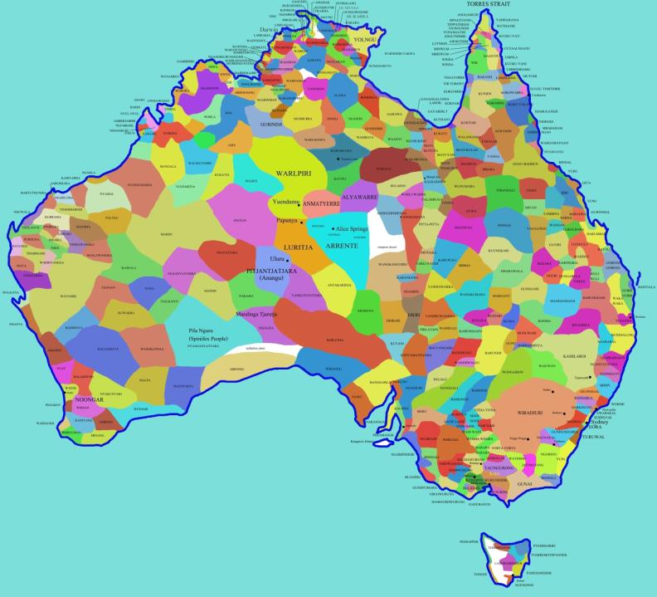
Aboriginal Australia Map
_{Copyright Christine Reid}
Notes:
The map shows the approximate areas each Aboriginal language group lived in. There are 250 language groups and within the language groups there are dialects.
The map can be used to illustrate the diversity of the Aboriginal nations and to illustrate the multicultural nature of Australia before colonisation.
The white areas on the maps are unknown language groups.

Slide 4
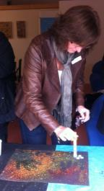
Preparation
Become familiar with the Aboriginal history of your area e.g. people, organisations, council
Undertake personal development e.g. music, art, reading, museums, internet, YouTube, lectures
Undertake professional development
Audit your school’s curriculum, personnel and resources
Form a network sharing teaching strategies and resources
Excursions with access to Aboriginal guides
Listen to the voices of Aboriginal people
_{Copyright Christine Reid}
Notes:
Many teachers are afraid to include an Aboriginal or Torres Strait Islander perspective into their work due to lack of knowledge. This means that nothing happens and the students miss out on gaining important information.
local councils including the Adelaide city council has and Aboriginal link.
Aboriginal health organisations, sobriety groups, local cultural groups plus parents from your school.
YouTube and put in the name of an Indigenous artist, e.g.. Archie Roach and you will become linked to other Aboriginal artists.
Visit the Indigenous component of your local museum, for example, The SA museum and art gallery, The National Museum, The NT museum and art gallery have large areas devoted to Aboriginal culture. Read the information with the displays.
Libraries have books that can be accessed for free. Books can be purchased from art galleries and museums. Museums and Universities often offer free lectures with an Aboriginal focus. There are art galleries or art displays with an Indigenous focus all around Australia.
Professional development
Find out how much knowledge is already available within your school, do you have teachers that have taught Aboriginal students or studied Aboriginal culture or have an Aboriginal background and are willing to share their information. Find out what material is available in your school library.
Develop networks across schools in your region or schools within areas with large numbers of Aboriginal students.
Find out what excursions can be accessed within your region. Listen to what Aboriginal people say on the excursions.
Talk and ask questions.
Watch out for opportunities where you can gather information.
If this becomes a passion there are university courses that you can complete.

Slide 5
What elements should be considered when embedding Aboriginal and Torres Strait Islander Histories and Culture into the curriculum?
_{Copyright Christine Reid}

Slide 6
Grab Attention
Fire Imagination
Hold Interest
_{Copyright Christine Reid}
Notes:
Be creative, you want to grab the student’s attention, fire their imagination and hold their interest. Don’t just read a Dreaming story or talk about the past. There are many interesting aspects of Aboriginal and Torres Strait Islander cultures and histories that can spark students’ interests. The students in the photographs are participating in cooking and sampling using Indigenous food and playing Aboriginal games as part of sports day.
Photography, copyright Christine Reid

Slide 7
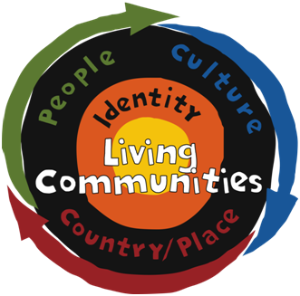
Aboriginal and Torres Strait Islander histories and cultures Conceptual Framework
_{Copyright Christine Reid}
Notes:
A conceptual framework based on Aboriginal and Torres Strait Islander Peoples’ unique sense of Identity has been developed as a structural tool for the embedding of Aboriginal and Torres Strait Islander histories and cultures within the Australian curriculum.
This sense of Identity is approached through the interconnected aspects of Country/Place, People and Culture, within the knowledge that Aboriginal and Torres Strait Islander communities still embrace their histories and culture today.

Slide 8
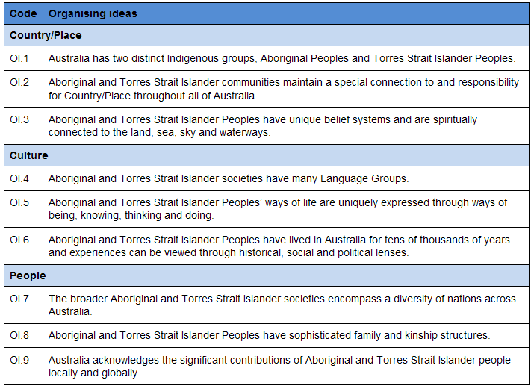
Set of Organising Ideas
_{Copyright Christine Reid}
Notes:
For each cross-curriculum priority, a set of organising ideas reflects the essential knowledge, understandings and skills for the priority.
The organising ideas are embedded in the content descriptions and elaborations of each learning area as appropriate.

Slide 9
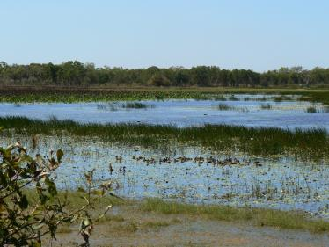
Explore Identity through Country/Place
‘We don't own the land, the land owns us. The land is my mother, my mother is the land. Land is the starting point to where it all began. It's like picking up a piece of dirt and saying this is where I started and this is where I'll go. The land is our food, our culture, our spirit and identity.’
*Knight S
_{Copyright Christine Reid}
Notes:
The next series of slides will look at the Framework and the organizing ideas in more detail.
OI 1 Australia has two distinct Indigenous groups; Aboriginal peoples and Torres Strait Islander peoples.
OI 2 Aboriginal and Torres Strait Islander communities maintain a special connection to and responsibility for Country/Place throughout all of Australia.
S Knight explains how her identity can not be removed from the land in the quote.
*Knight S., 1996, Our Land Our Life, card, Aboriginal and Torres Strait Islander Commission, Canberra

Slide 10
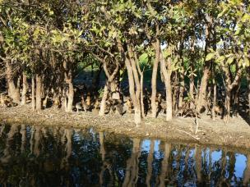
Spiritual Song of the Aborigine
I am a child of the Dreamtime People
Part of this Land, like the gnarled gumtree
I am the river, softly singing
Chanting our songs on my way to the sea
My spirit is the dust-devils
Mirages, that dance on the plain
I'm the snow, the wind and the falling rain
I'm part of the rocks and the red desert earth
Red as the blood that flows in my veins
I am eagle, crow and snake that glides
Thorough the rain-forest that clings to the mountainside
I awakened here when the earth was new
There was emu, wombat, kangaroo
No other man of a different hue
I am this land
And this land is me
I am Australia.
*Poem by Hyllus Maris.
_{Copyright Christine Reid}
Notes:
OI 1 Australia has two distinct Indigenous groups; Aboriginal peoples and Torres Strait Islander peoples.
OI 2 Aboriginal and Torres Strait Islander communities maintain a special connection to and responsibility for Country/Place throughout all of Australia.
Aboriginal author and Yorta Yorta woman Hyllus Maris (1934-86) expressed this connectedness with the land beautifully in her poem Spiritual Song of the Aborigine.
*Spiritual Song of the Aborigine, Hyllus Maris, in: Discover...The Australian Aborigines, 1998, p.18
Photography, copyright Christine Reid

Slide 11
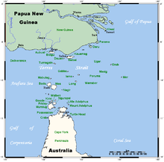
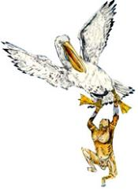
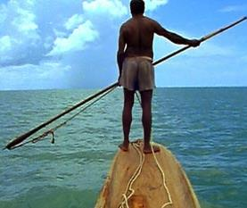
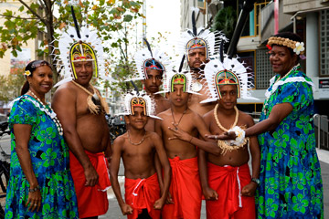
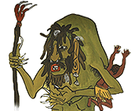
Explore Identity through Country/Place
“On the islands, life continues to revolve around the sea and the changing seasons.”
_{Copyright Christine Reid}
Notes:
OI 1 Australia has two distinct Indigenous groups; Aboriginal peoples and Torres Strait Islander peoples.
OI 2 Aboriginal and Torres Strait Islander communities maintain a special connection to and responsibility for Country/Place throughout all of Australia.
The Torres Strait Islander people are related to the New Guinean people.
They come from a series of islands between Papua New Guinea and Australia.
Fishing was the main occupation.
The ceremonial head dress has become their emblem and is shown as the centerpiece of their flag.
Tagai is the mythological creature shown in the slides.
Torres Strait Islander people do not have Dreaming stories, instead they have mythology and legends.

Slide 12
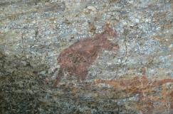
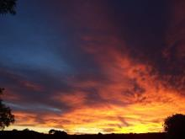
Explore Identity through Country/Place
Tell stories
Investigate
Dance
Astronomy
Animals
Food
Relationships
Sing
Compare
Songs
Plants
THE DREAMING
Paint
Art
Language
Use themes
Land
Technology
Spirituality
Behaviour
Adapted from *W H Edwards’
Introduction to Aboriginal Societies
Act
Write
_{Copyright Christine Reid}
Notes:
O I.3 Aboriginal and Torres Strait Islander Peoples have unique belief systems and are spiritually connected to the land, sea, sky and waterways.
The wheel shows us that The Dreaming encapsulates all aspects of life.
The stories explain the spiritual, the physical and the relationships between people.
The Dreaming stories can be investigated through telling, dancing, looking at themes, comparing similar stories from different language groups, acting, writing, painting, singing, investigating.
The Dreaming is an English name but each Aboriginal nation has its own name, for example it is the Tjukurrpa for Pitjantjatjara people and the Altyerrenge for Arrernte people.
The Dreaming is the time when the Ancestral Beings moved across the land and created life and significant geographic features.
The Dreaming also means to see and understand the law.
Dreaming stories pass on important knowledge, cultural values and belief systems to later generations, this is done through song, dance, painting and storytelling which express the Dreaming stories,
When the ancestor spirits had finished creating the world they changed into the trees, rocks, rivers, stars and other physical objects. These are now the sacred places for the Aboriginal people. The Dreaming is never-ending, it links the past and the present to the people and the land.
*W H Edwards, Introduction to Aboriginal Societies, Social Science Press, Wentworth Falls, NSW 1988, the second edition was published by Thomson in 2007.
Photography, copyright Christine Reid

Slide 13
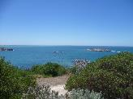
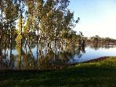
Explore Identity through Culture
Relationship with environment
Effects of colonisation
Pre-European settlement
Dwellings
Technology
LANGUAGE GROUP
Past and Present
Dreaming stories
Influential People
Place Names
Early maps of the area
Arts/crafts: traditional, contemporary
Self- determination
Seasonal food trail
_{Copyright Christine Reid}
Notes:
OI 4 Aboriginal and Torres Strait Islander societies have many language groups.
Explore identity through looking at the culture of different language groups. Place the language group that you want to learn about in the centre e.g. Pitjantjatjara or Kaurna, then research both the past and the present using the headings. An example of this could be looking at the technology of the past – boomerangs, then technology of the present, modern Aboriginal inventors.
Photography, copyright Christine Reid

Slide 14
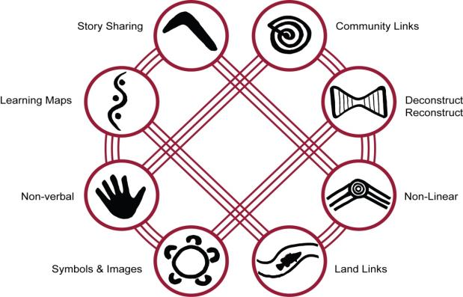
Explore Identity through Culture
8 ways of learning
Being
Doing
Knowing
Thinking
*8ways.wikispaces.com
_{Copyright Christine Reid}
Notes:
OI 5 Aboriginal and Torres Strait Islander Peoples’ ways of life are uniquely expressed through ways of being, knowing, thinking, and doing.
8 ways of learning - a pedagogy framework that allows teachers to include Aboriginal perspectives by using Aboriginal learning techniques. Tell a story. Make a plan. Think and do. Draw it. Take it outside. Try a new way. Watch first, then do. Share it with others. Teaching through Aboriginal processes and protocols, not just Aboriginal content validates and teaches through Aboriginal culture and may enhance the learning for all students.

Slide 15
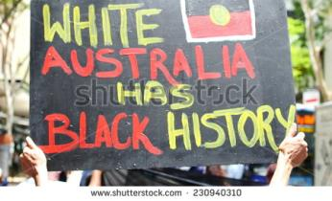
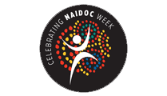
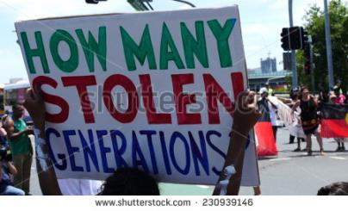
What is the Indigenous Perspective on History?
Explore Identity through Culture
Terra Nullius ~ Resistance ~ Retaliation Destruction ~ Massacre
Whose voice is heard / not heard?
“The effects of practices such as these have resulted in inter-generational trauma for Indigenous Australians, as well as disadvantage, lack of access and equality, and lack of social justice.”
Dr Lowitja O’Donoghue
to a hearing of the National Inquiry
Bringing Them Home ~ Journey of Healing
~ National Reconciliation Week ~
Sorry Day ~ NAIDOC ~ Closing the Gap
_{Copyright Christine Reid}
Notes:
OI 6 Aboriginal and Torres Strait Islander Peoples have lived in Australia for thousands of years and experiences can be viewed through historical, social and political lenses.
There are two perspectives on history, the Indigenous Australian and the Colonising people. Inquiry questions can be developed based on Was it Colonisation or Invasion? Is it Australia Day or Survival Day? What is the Indigenous perspective on history?
Racism no way provides many teaching ideas and resources,
National Reconciliation Week:
Sorry Day:
NAIDOC
Closing the gap:
Stolen Generation:

Slide 16
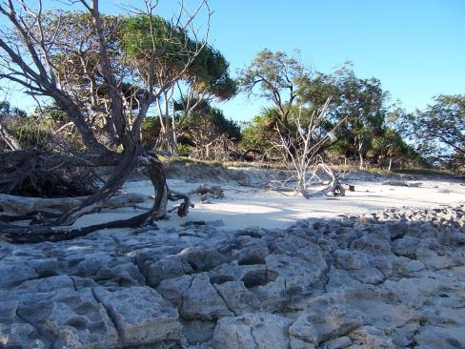
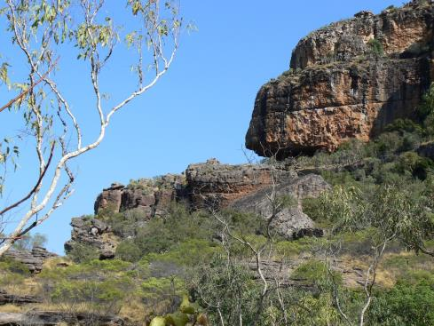
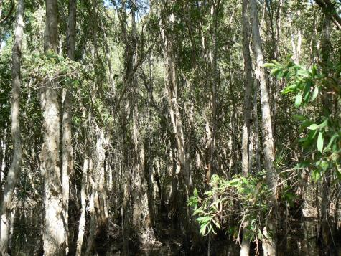
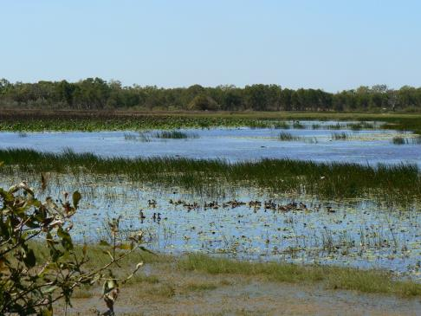
Explore Identity through People
DIVERSITY
food
shelter
art
clothing
technology
story
_{Copyright Christine Reid}
Notes:
OI 7 The broader Aboriginal and Torres Strait Islander societies encompass a diversity of nations across Australia.
Explore the diversity of Aboriginal Australians, for example look at the food, art, technology, stories, clothing and shelter from different Aboriginal language groups. Choose people from different environments, the desert, the ocean, the rainforests, the mountains. What affects their needs? The resources available, the weather, the animals and birds available, the landscape, access to water?

Slide 17
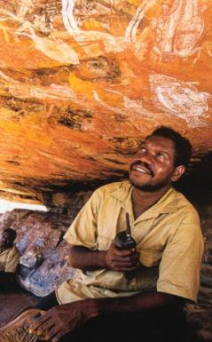
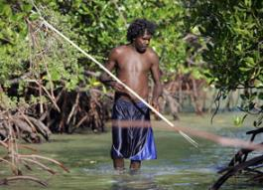
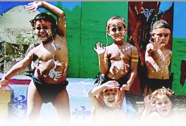
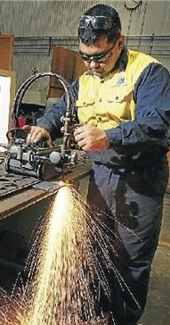
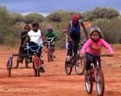
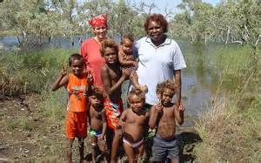
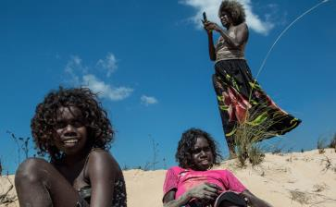
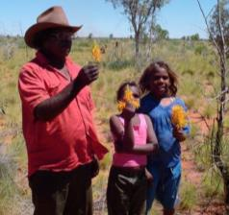
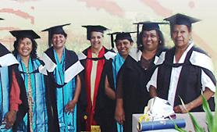
Explore Identity through People
Clans
Kinship Systems
Responsibilities
Moities
Extended Families
Totems
_{Copyright Christine Reid}
Notes:
OI 8 Aboriginal and Torres Strait Islander Peoples have sophisticated family and kinship structures.
Explore
Kinship Systems:
Clans:
Moities:
Totems:
Extended families and responsibilities:
Tom Tom by Rosemary Sullivan and illustrated by Dee Huxley is a delightful book for younger primary aged readers. It provides an excellent example of extended families and responsibilities. The author has a web site with activities connected to the book, this is available at http://www.lemonadesprings.com.au/.

Slide 18
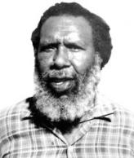
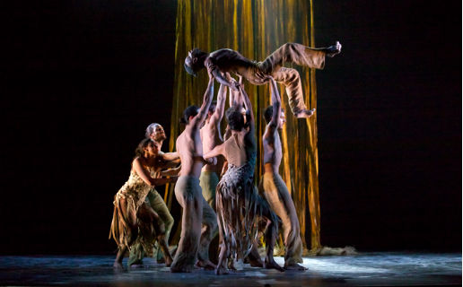
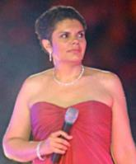
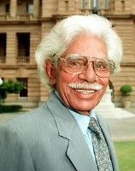
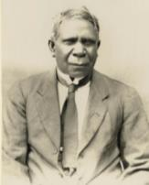
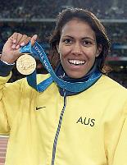
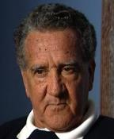
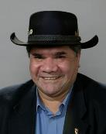
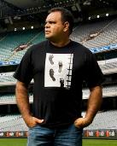
Explore Identity through People
Significant Indigenous Australians
_{Copyright Christine Reid}
Notes:
OI 9 Australia acknowledges the significant contributions of Aboriginal and Torres Strait Islander people locally and globally.
Students could research in the areas of politics, art, music, dance, literature, sport, inventions.
The people included on this slide are Centre the Bangarra Dance Company, then from Top right, Jessica Mauboy, Neville Bonner, Cathy Freeman, Michael Long, Shelley Reys, Mick Dobson, Charlie Perkins, David Unaipon, Deborah Cheetham, Eddie Mabo.

Slide 19
Aboriginal and Torres Strait Islander histories and cultures included across the Learning Areas in the Australian Curriculum?
_{Copyright Christine Reid}
Notes:
The following series of slides will focus on the Australian Curriculum, Aboriginal and Torres Strait Islander histories and cultures in the Learning Areas of History, Geography, English, Science and Mathematics.
There is a cross over with the Indigenous component across learning areas, for example, examining the ‘Seasonal calendar’ is in History, Geography, Science and Mathematics.

Slide 20
Stories of the past
Early contact history
Dreaming stories
Indigenous seasonal calendars
Frontier conflict events
oral tradition
Traditional Indigenous games
Contributions to devt of colony
Contribution to devt of Aust. society
Cultures, then and now
AC: HISTORY
Local language group
Impact of govt legislation
Celebrations, past and present
Involvement in wars
Fight for recognition and rights
Importance of Country
Diversity and longevity of First Peoples
Family life - past and present
Significant sites
Structures and roles
Ancient Australia and what it reveals,
e.g. Lake Mungo, shell middens
Kinship groups
Racism and prejudice
Signs/symbols of commemoration
History of Reconciliation movement

Slide 21
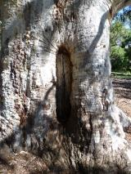
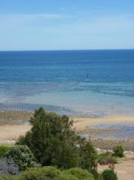
Australian Curriculum - History
Foundation Year
Stories of the past
Dreaming stories
Kinship groups
Structures and roles
Celebrations
Communication
Year 1
Kinship system
Seasonal calendars
Oral Histories
Family life – past and present
Year 2
Local language group
Cultures, then and now
Year 3
Local language group
Cultures, then and now
Significant sites
Celebrations
Signs/symbols of commemoration
_{Copyright Christine Reid}
Notes:
Foundation Compare similarities and differences among the families in the class.
Discuss importance of extended family to Indigenous people – the challenge of keeping in contact with family living in the city and the country
Gather images of Aboriginal and Torres Strait Islander people of varying ages from all areas of Australia.
Compare pictures of a range of different family groups – Indigenous and non-Indigenous
The Importance of ‘family’ common across cultures
Respect for Elders, especially in Asian and Indigenous cultures
Uncles and aunties performed the same role as parents, they are the teachers and disciplinarians.
Bush games and Knucklebones by Doris Katinyeri
Discuss why community commemorations such as National Reconciliation Week and NAIDOC week are important. How are these events celebrated?
Year 1, Teaching Resources
My Place by Nadia Wheatley, illustrated by Donna Rawlins. Moving backwards in decades from 1989, the book shows how a particular neighbourhood in Sydney has changed from a modern urban street to the first white settlement and earlier to the time when the Aborigines lived there. The story is told through the eyes of the various children who lived there.
Tom Tom, Author: Sullivan Rosemary
As I grew older & Tucker by Ian Abdullah
These autobiographical works are about Ian’s life experiences growing up in the Riverland. He wanted to record what live was like in his community. His paintings give reality to the book.
Aboriginal perspectives in the WA curriculum,families
Walking with Seasons in Kakadu, by Diane Lucas
From ochres to eel traps: Aboriginal science and technology resource guide for teachers. By Helen Halling, Canberra : Science Educators Association*ACT., page 38
Indigenous Weather Knowledge, Australian Bureau of Meteorology. (2002), http://www.bom.gov.au/iwk/
The Lost Seasons, http://www.abc.net.au/science/features/indigenous/
Celebrating NAIDOC, http://www.naidoc.org.au/
Celebrating Reconciliation Week – https://www.reconciliation.org.au/ and http://www.reconciliationsa.org.au/
Tracker Tjugingji by Bob Randall
Year 2, Teaching resources
Profile significant Indigenous leaders in the community
Are there any natural landmarks or man-made stites which have cultural significance to Aboriginal and Torres Strain Islander peoples?
David Uniapon, adb.anu.edu.au/biography/unaipon-david-8898
Most Botanical Gardens now have an Indigenous area for example Adelaide Botanic Gardens Indigenous trail
Bushgames and Knucklebones by Doris Katinyeri
Bush Toys – Aboriginal children at play, Claudia Haagen (teachers resource)
Play some traditional Aboriginal games, http://www.creativespirits.info/aboriginalculture/sport/traditional-aboriginal-games-activities
Year 3 Teaching resources.
Where possible focus on the local indigenous people of the area
55,000 years and counting, celebrating our shared history, South Australian Education Pack
Look at local council web sites and pamphlets
Map of Aboriginal Australia, refer to Slide 2 for details
Indigenous Australian Contact History Timelines
Missions and Reserves,
Aboriginal perspectives in the WA curriculum, ANZACS(teacher’s reference)
Education Pack, Forgotten heroes: Honouring the Service and Sacrifice of Aboriginal and Torres Strait Islander Peoples available at Ngarrindjeri Anzacs, Doreen Kartinyeri, Aboriginal Family History Project
The Apology, 12th February, 2008, http://www.australia.gov.au/about-australia/our-country/our-people/apology-to-australias-indigenous-peoples
Reconciliation
Celebrating NAIDOC,
Celebrating Reconciliation Week – https://www.reconciliation.org.au/ and http://www.reconciliationsa.org.au/
Look for signs and symbols of commemoration of Aboriginal and Torres Strait Islander presence in the local community, check plaques, street signs, monuments, renaming of significant parks, sites, roads, rivers
Refer to City Council websites, e.g. Adelaide, Onkaparinga
Outline of Kangaroo, a significant traditional Kaurna symbol
Kaurna shield, a significant traditional Kaurna symbol
$50 note, with images of Ngarrindjeri man, David Unaipon, and the Raukkan Church
Reconciliation SA’s hand symbol
Journey of Healing’s ‘Walking Together’, strong Reconciliation symbol.
Photography, copyright Christine Reid

Slide 22
Australian Curriculum - History
Year 4
Diversity and longevity of First Peoples
Traditional life
Ancient Australia and what it reveals
Early contact history
Frontier conflict events
Relationship with the land
Year 5
Contributions to the development of a colony
Impact of colonisation, including massacres
Year 6
Impact of Government legislation
Fight for recognition and rights
Contribution to development of Australian society
John Allcot (1888-1973), The First Fleet in Sydney Cove, January 27, 1788, 1938, art reproduction. Image courtesy of the National Library of Australia.
_{Copyright Christine Reid}
Notes:
Year 4 Teaching Resources
Access Aboriginal Australia and Indigenous Language maps
Compare and contrast two or more different Aboriginal nations, for example the Ngarrindjeri and the Pitjantjatjara nations.
Investigate p-re-contact ways of life of the Aboriginal people and/or Torres Strait Islanders; their knowledge of their environment including land management practices; their sense of the interconnectedness of Country/Place, People, Culture and Identity; and some of their principles (such as caring for country, caring for each other and respecting all things).
Select three different locations, e.g. tropical (Yolgnu/Torres Strait Islander), desert (Arrente/Anangu) and river (Narrindjeri) and highlight the diversity of resources, technology, art/craft, clothing, story ….
Research the trade routes which were all the way from South Australia to Arnhem Land. (slide 13)
Seeking permission to enter the Country of another group was a sign of respect NOT shown by European arrivals. Investigate ‘Welcome to country’. See slide 1 for additional information.
Compare and contrast an Aboriginal nation with a Torres Strait Islander community.
Aboriginal perspectives in the WA curriculum, Living with country
Use books specific to an Aboriginal nation, for example:
The Dreaming Wheel adapted from An Introduction to Aboriginal Societies by W H Edwards (1988, p13). (see slide 13 for additional information)
Lake Mungo. Our story, authors are Johnno Mitchell, Leanne Taylor, Naomi Carr, Raeleen Berriman, Ron Jackson, Roslyn Thorpe and Vanessa Dyke. Indij readers, 3rd series.
The Dreaming, a six series collection on DVD and the Teachers guide for The Dreaming, available through http://www.thedreamingstories.com.au/ phone 02 83588610.
Dust Echoes, http://www.abc.net.au/dustechoes/
Aboriginal Dreaming stories, birds and the local environment; A strategy for early and primary years R-5 by Trefor Barnes, http://www.readbag.com/aboriginaleducation-sa-au-files-links-dreaming-stories-and-bird
Macassan contacts -
In South Australia, the Migration Museum has an Indigenous programme, including, the Aboriginal history in South Australia since 1800 role play.
The Rabbits, written by John Marsden,
First contact varied in terns of aggression, understanding and cooperation, depending on approaches used and the nature of the Indigenous peoples.
Compare the European concept of land ownership with the Aboriginal and Torres Strait Islander peoples’ relationship with the land and sea, and how this affected relations between them
Seeking permission to enter the Country of another group was a sign of respect NOT shown by European arrivals.
Warriors
Truganini; http://adb.anu.edu.au/biography/trugernanner-truganini-4752
Aboriginal people who cooperated with Europeans, including Bennelong.
The coming of the light, Video Known as the ‘Coming of the Light’, it was the arrival of British missionaries spreading Christianity which profoundly changed island life. These days the occasion is celebrated each year by religious festivities throughout the islands and among Torres Strait Islander communities on mainland Australia.
A research topic could be the impact of Diseases on Aboriginal people in Australia.
For example, disease reached Kaurna peoples in 1789 and it is guesstimated that about 50% of the population had died before the arrival of the Buffalo in 1836. By 1857, the Kaurna people had virtually disappeared as an Aboriginal nation on the Adelaide Plains due to disease, dispossession and displacement to Poonindie, Point McLeay and Point Pearce etc.
Songlines also became a pathway for the spread of disease.
Trade routes also became a pathway for the spread of disease.
Positive or negative effects of the interaction between Europeans and Aboriginal and Torres Strait Islander people
Loss of life
Loss of Lands
Clearing of land, destruction of habitat, loss of food sources
Loss of culture, language, spirituality
Desecration of sacred sites
Loss of family, connectedness
Forced onto a foreign diet
Forced in lowly paid jobs – labourers, station hands, servants
Examine landscape paintings and accounts of flora and fauna (by observers such as Watkin Tench and David Collins) to determine the impact of early British colonization on the environment.
Year 5 Teaching Resources
Research primary and secondary sources to locate stories, diaries, photographs, artefacts, written documents, online information, and extracts from journals that give insights into early interaction between Indigenous and non-Indigenous people.
View the paintings in the visions of Adelaide kit and describe what these paintings tell you about Adelaide at around the time of settlement, accessed through http://www.artgallery.sa.gov.au/agsa/home/Learning/docs/Online_Resources/ED05VisionsOfAdelaide.pdf
Visit the Aboriginal cultural galleries at your local museum.
Find images on data bases, for example the South Australiana data base, http://www.slsa.sa.gov.au/site/page.cfm?u=377
Discuss what happened when European settlements were established at various sites around Australia e.g. Sydney. Investigate the Indigenous perspective on the events that occurred at those places. How would you have felt if you were an Indigenous person?
What impact did European settlement have on the local people from your area? How would you have felt if you were an Indigenous person?
Indigenous Australian Contact History Timelines
South Australian Letters Patent: ‘Provided Always that nothing in those our Letters Patent contained shall affect or be construed to affect the rights of any Aboriginal Natives of the said Province to the actual occupation or enjoyment in their own Persons or in the Persons of their Descendants of any Lands therein now actually occupied or enjoyed by such Natives’, http://foundingdocs.gov.au/item-did-2.html
Too many Captain Cooks by Alan Tucker
Research the relationship between Indigenous Australians and convicts.
Art Galleries, look at art work depicting the relationship between Aboriginal Australians and the settlement of Australia or in particular your area.
Missions and Reserves,
Massacres
Myall Creek Massacre, 10th June,1838; http://www.myallcreekmassacre.com/Myall_Creek_Massacre/Home.html
Pinjarra Massacre; http://www.pinjarramassacresite.com/
Frontier contact as opposed to First Contact – see Homelands and Frontiers by Alan Tucker
Kimberley Warrior – Jandamurra
Battara resistance (poisoned flour, Eyre Peninsula)
Create ‘what if’ scenarios by constructing different outcomes for a key event, for example ‘What if Peter Lalor had encouraged gold miners to pay rather than resist licence fees?’
Role of Aboriginal stockmen on stations
Role of Aboriginal trackers in the Outback e.g. Jacky Jacky or Jimmy James
Role of Aboriginal domestic servants
YEAR 6 teacher resources
Analyse the impact of particular legislation on Australian Indigenous people
Select some key dates and explain what happened at time in South Australia’s history to the Australian Indigenous people.
Human Rights Education Resource for teachers; https://www.humanrights.gov.au/human-rights-education-and-training
Citizenship: Let’s talk Recognition, South Australian Education Pack, 2011; http://www.reconciliationsa.org.au/assets/media/files/Education%20Packs/Citizenship_Lets_Talk_Recognition.pdf
The Little Red Yellow and Black Book: An Introduction to Indigenous Australia, Bruce Pascoe, AIATSIS, Aboriginal Studies Press, October 2008
AIATISIS; http://aiatsis.gov.au/
Research Piltawodli - German Missionary School: http://adelaidia.sa.gov.au/places/piltawodli
Piltawodli - “place of possums” - sits in the middle of the Adelaide Parklands. Between 1839 and 1845 this area was one of the first in South Australia to see the forced settlement of Indigenous Australians. Two German missionaries took the plunge and decided to settle there as well, intending to school the Indigenous inhabitants in mathematics, geography and religion. The language of the Kaurna also fascinated these highly educated missionaries and, thanks to their records, the language has been saved from extinction.
Research Federation and the Australian Aboriginal people
Racism
Babakiueria (Barbeque area), Don Featherstone, Australia, 1986, 30 minutes - The film Babakiueria shows how Aboriginals are represented in society through taking a sarcastic look at racial stereotypes.
It starts with a boat approaching a barbeque area and a group of Aboriginal people taking possession of this area and all “Babakiuerians”. It continues to present many Aboriginal issues with the roles swapped: White people are a minority; white kids are taken from their families or white people being moved to another place because the black government needs their home for “something”.
The Apology to the Stolen Generations, Reconciliation Australia, May 2008 (Film - 30 minutes)
How did recognition and rights of Aboriginal and Torres Strait Islander peoples improve during the 20th Century?
Charles Perkins and the Freedom Ride of 1965; http://indigenousrights.net.au/civil_rights/freedom_ride,_1965
Referendum of 1967; http://www.naa.gov.au/collection/fact-sheets/fs150.aspx
Land Rights e.g. Vincent Lingiari, Eddie Mabo
Tent Embassy
Investigate the history of events that led up to the Reconciliation movement.
Research significant dates, e.g. removal, assimilation, Native Title
Discuss Prime Minister Kevin Rudd’s 2008 ‘Apology’ and responsible political decisions which aim to address contemporary Indigenous issues in society.
See Civics Issues series – Indigenous Australians by Terry Hastings (Macmillan)
Famous Indigenous Australians, Use the list below as a research list.
Investigate the roles of Indigenous men and women whose work involves providing goods and services for a community, e.g. health care workers, Aboriginal/Indigenous Education Workers, community guides, park rangers …Consider those working in very remote as well as urban areas.
Why is it important to have people working in these areas?
Indigenous people involved in the Entertainment industry including professional singers, dancers, actors, sportspeople.
Indigenous ANZACS
Investigate treatment of Indigenous servicemen after the wars – social justice issues
Photography, copyright Christine Reid

Slide 23
Australian Curriculum - History
Year 7
Ancient Australia and what it reveals, e.g. Lake Mungo, Kimberley art and shell middens
Year 9
Impact of Government legislation
Fight for recognition and rights
History of Reconciliation movement
Impact of free settlers on Aboriginal and Torres Strait Islander people
Effects of contact
Involvement in World War 1
Year 10
Racism and prejudice
Fight for rights and freedom
Stolen Generation, Mabo, Reconciliation, The Apology
Charles Perkins and the Freedom Riders
1967 Referendum
Declaration on the Rights of Indigenous Peoples (2007)
Aboriginal musicians, performing artists and sports people
_{Copyright Christine Reid}
Notes:
YEAR 7
Lake Mungo. Our story, authors are Johnno Mitchell, Leanne Taylor, Naomi Carr, Raeleen Berriman, Ron Jackson, Roslyn Thorpe and Vanessa Dyke. Indij readers, 3rd series.
Lake Mungo: http://nma.gov.au/blogs/education/2012/06/01/new-lake-mungo-education-resource/ and http://www.mungoexplorer.com.au/
Shell Middens; http://www.environment.nsw.gov.au/nswcultureheritage/ShellMiddens.htm and http://www.aboriginalheritage.tas.gov.au/middens
Kimberley Bradshaw paintings; http://www.bing.com/images/search?q=Kimberley+Bradshaw+paintings&qpvt=Kimberley+Bradshaw+paintings&FORM=IGRE and http://bradshawfoundation.com/bradshaws/
YEAR 8
There are no Depth Studies that relate to Indigenous Australians
Year 9
Timeline of Legislation affecting Aboriginal Australians: http://australianmuseum.net.au/indigenous-australia-timeline-1901-to-1969 and http://api.ning.com/files/ARWw4Em1WfPTDYzYsqSnK1Tbv43h85vz2Tc2a80xWdOaAzm2goSOUjbWhrfT5lDOJMhgsi4Aq9iXJxcNGqa*EPi3smmF9uoH/Timeline_of_legislation_af.pdf
Article 12: European Convention on Human Rights
Research the History of Indigenous Education
Human Rights Education Resource for teachers; https://www.humanrights.gov.au/human-rights-education-and-training
Citizenship: Let’s talk Recognition, South Australian Education Pack, 2011; http://www.reconciliationsa.org.au/assets/media/files/Education%20Packs/Citizenship_Lets_Talk_Recognition.pdf
The Little Red Yellow and Black Book: An Introduction to Indigenous Australia, Bruce Pascoe, AIATSIS, Aboriginal Studies Press, October 2008
AIATISIS; http://aiatsis.gov.au/
Research Federation and the Australian Aboriginal people
Assimilation; http://www.skwirk.com/p-c_s-56_u-120_t-328_c-1126/what-was-assimilation-/nsw/what-was-assimilation-/changing-rights-and-freedoms-aboriginal-people/stealing-a-generation-asssimilation-
Racism
Racism; http://www.racismnoway.com.au/
Countering Racism – Using a critical approach in teaching and learning contexts to explore portrayals of Aboriginality, Department of Education, Training and Employment
Forgotten heroes: Honouring the Service and Sacrifice of Aboriginal and Torres Strait Islander Peoples; http://www.reconciliationsa.org.au/assets/media/Forgotten%20Heroes.pdf
Survival in our own land ‘Aboriginal’ Experiences in ‘South Australia’ since 1836, told by Nungas and others, edited and researched by Christobel Mattingley, co-edited by Ken Hampton
Sorry Day, (Journey of Healing Day in South Australia), find education resources, Australian Schools National Sorry Day at http://www.nsdc.org.au/ (teacher’s reference)
The Stolen Generation, South Australian Education Pack
The Apology, 12th February, 2008, http://www.australia.gov.au/about-australia/our-country/our-people/apology-to-australias-indigenous-peoples
The Apology to the Stolen Generations, Reconciliation Australia, May 2008 (Film - 30 minutes)
Electoral Milestone/timetable for Indigenous Australians; http://www.aec.gov.au/indigenous/milestones.htm
History of the Indigenous vote; http://www.aec.gov.au/indigenous/history.htm
Celebrating NAIDOC, http://www.naidoc.org.au/
Celebrating Reconciliation Week – https://www.reconciliation.org.au/ and http://www.reconciliationsa.org.au/
Charles Perkins, Freedom Rides: http://indigenousrights.net.au/civil_rights/freedom_ride,_1965 and http://dl.nfsa.gov.au/module/1033/
Mabo; http://www.mabonativetitle.com/
Declaration on the Rights of Indigenous Peoples (2007); https://www.humanrights.gov.au/publications/un-declaration-rights-indigenous-peoples-1
Indigenous Australian health data:
Summary of Indigenous health; http://www.healthinfonet.ecu.edu.au/health-facts/summary
Statistical overview of Indigenous health; https://www.humanrights.gov.au/publications/statistical-overview-aboriginal-and-torres-strait-islander-peoples-australia-social
National Archives of Australia, fact sheets about Indigenous people and events; http://www.naa.gov.au/collection/fact-sheets/on-indigenous-australia/index.aspx
Aboriginal Australian musicians:
Aboriginal music; http://www.creativespirits.info/resources/music/
Aboriginal musicians; http://en.wikipedia.org/wiki/List_of_Indigenous_Australian_musicians
Aboriginal Australian actors:
Performing artists; http://en.wikipedia.org/wiki/List_of_Indigenous_Australian_performing_artists
Aboriginal Australian sports people:
Indigenous Australian sportspeople; http://en.wikipedia.org/wiki/List_of_Indigenous_Australian_sportspeople
Aboriginal sport; http://www.creativespirits.info/aboriginalculture/sport/
Moorditj, Australian Indigenous Cultural Expressions, Dare to Lead project. Interactive computer CD features 300 artworks from 111 Indigenous Australian artists. Indigenous craft, dance, literature, media, music, oral history, theatre and visual arts.
Photography, copyright Christine Reid

Slide 24
Spatial patterns of diversity now and in the past
Exploring Indigenous agricultural and food security practices
Identifying and using the name of the local Aboriginal or Torres Strait Islander Peoples
Exploitation of local natural resources
Ethical research
Using the words ‘country’, ‘place’ and ‘nation’, investigating how they are used for the places they belong to
Approaches to custodial responsibility and land management
Living on Country/Place
Investigate remoteness
Variations in human wellbeing
Identifying places considered to be ‘special’
Multilayered meanings of landscapes and landforms
AC: GEOGRAPHY
The value placed on water
Discuss the way location and connection between places and features are represented e.g. stone, stories, paintings, song, dance
Environmental characteristics that have been shaped through knowledge and practices
Connections to places in Australia, Asia and the world
Rotational use and sustainable harvesting
Names and meanings for local features
Examine changes in natural, managed and constructed features, e.g. fires, farming, fish traps
Identify connections to countries, marriage, birth, residence
Adaptation to environment
Feelings about places, poems, stories
Investigate Dreaming stories that explain distinctive features
Use language maps
Seasonal calendars

Slide 25
Australian Curriculum - Geography
Foundation Year
Discussion the location and connection between places and features are represented e.g. stone, stories, paintings, song, dance.
Identifying and using the name of the local Aboriginal or Torres Strait Islander Peoples.
Using the words ‘country’, ‘place’ and ‘nation’, investigate how they are used for the places they belong to.
Identify places considered to be special.
Year 1
Recount Dreaming stories and Legends of the Torres Strait that identify the natural features of a place.
Compare Seasonal Calendars.
Year 2
Investigate names and meanings for local features
Identify and discus connections to countries through marriage, birth, residence, movement
Describe connections to land, sea and animals
_{Copyright Christine Reid}
Notes:
Foundation Year teaching resources
GECKOS, WA – explains meaning of Country; http://geckos.ceo.wa.edu.au/primary/country/Pages/country.aspx. Discuss the protocols around welcoming family, friends and/or special guests who visit their homes. Introduce the concept of ‘Welcome to Country’ and ‘Acknowledgement of Country’.
Painting and Maps - Aboriginal perspectives in the WA curriculum, http://www.det.wa.edu.au/aboriginaleducation/apac/detcms/portal/ (Lesson Plans)
As a class, students create a ‘map-painting’ of their local community, representing significant physical features with symbols in the traditional Aboriginal way - using the aerial landscape technique
Organise an incursion whereby a local Aboriginal dance group performs a selection of dances for students. Invite a member of the dance group to talk to the students about the stories behind the dances – their meaning and significance – and to answer student questions about the dances after the performance.
Focus on the ‘who, what, when, where’ of the story, with students offering their interpretations
Students contribute to an oral retelling of the story/stories
Dancers share the ‘why’ of the dance (passing on the culture visually)
Dancers share what local Aboriginal people made dances about
Students enact part of the dance of their choice.
Find the location of your school and/or home on a map then compare the names on the Aboriginal Australia map, learn whose land your school or home is built on.
You and Me: Our Place by Leonie Norrington and Dee Huxley
Nyuntu Ninti (what you should know) - Aboriginal perspectives in the WA curriculum, http://www.det.wa.edu.au/aboriginaleducation/apac/detcms/portal/ (Lesson Plans)
Year 1 Teaching Resources
Select Dreaming stories from The Dreaming DVD series, Identify the natural landforms that are featured in the stories. Illustrate in a table or by using Kid Pix or a similar program
Discuss the way in which Aboriginal people explain the creation of these landforms. How effective are these ‘creation stories’?
List what could happen if these significant natural landforms are not cared for or protected
Who looks after these significant natural landforms today? What can we do to help?
Recount the stories using simple illustrations as reminders of the main features of the story.
Dreaming Stories are available on Youtube –
The Seasons
Talk about the weather, the seasons, what happens each seasons, how do we know it is winter? etc
Talk about the current weather, what season is it now, what are the characteristics of this season.
Identify the current season of the year and its general characteristics
How do we know that the seasons have changed?
What are the features of the European based seasons used in your community?
Read and talk about Walking with the Seasons in Kakadu by Diane Lucas and My Home in Kakadu by Jane Christophersen and discuss the importance of the environmental signs in the natural world around us that indicate the changing seasons, e.g. leaves changing colour and/or dropping, flowers blooming, eggs being laid, baby animals being born, particular winds blowing, rain falling, the heat, the cold … …
Additional Aboriginal Seasons information can be found at
Indigenous Weather Knowledge, Australian Bureau of Meteorology. (2002), http://www.bom.gov.au/iwk/
The Lost Seasons, http://www.abc.net.au/science/features/indigenous/
Discuss and brainstorm why and how the different seasonal calendars differ.
Make a chart comparing non-Indigenous seasons with Kaurna (or another group) seasons, looking at: the number of seasons, names of seasons, weather experienced in each season, and
activities in which people were/are involved in each season
Seasons a unit of work found at GECKOS WA, http://geckos.ceo.wa.edu.au/primary/ecology/Pages/seasons.aspx
Year 2 Teaching Resources
Find the Aboriginal names of any significant sites in your local area, a web search will usually find information, for example Kaurna place names can be found at http://www.kaurnaplacenames.com/index.php; Wikapedia has a list that could be used as a starting point - http://en.wikipedia.org/wiki/List_of_Australian_place_names_of_Aboriginal_origin; additional information found at this web site - http://www.ourlanguages.net.au/languages/aboriginal-place-names.html
Ask students to think about their favourite place:
How did it become their special place?
What is their connection and how do they nurture their connection to this place?
How do they feel when they have spent time at their place?
Describe what this place does for their spirit, eg feeling happy, alive, rested, at peace, refreshed …
Illustrate their place using an art form of their choice - collage, painting, sculpture
Select a piece of music that reminds them of their special place.
Nyuntu Ninti (what you should know) - Aboriginal perspectives in the WA curriculum, http://www.det.wa.edu.au/aboriginaleducation/apac/detcms/portal/ (Lesson Plans)
Students could also listen to and view a song that demonstrates Aboriginal relationship with the land such as My Island Home by Neil Murray (by Christine Anu) at https://www.youtube.com/watch?v=OSFGK9HlEto, Lyrics to this song are available at http://www.lyricsfreak.com/c/christine+anu/island+home_20240451.html

Slide 26
Australian Curriculum - Geography
Year 3
Use Language maps
Feelings about places through poems, songs, paintings and stories
Protection of significant sites
Diversity of Aboriginal and Torres Strait Islander people
Year 4
Distribution of Aboriginal people before colonisation
Adaptation to the environment
Rotational use of resources and sustainable harvesting.
Year 5
Environmental characteristics that have been shaped through knowledge and practices.
Year 6
Ethical Research
_{Copyright Christine Reid}
Notes:
Year 3 Teaching resource
Display the Aboriginal Australia map and compare it to the political map of Australia showing the state and territorial borders. Copy a political outline map of Australia’s states and territories onto a clear transparency sheet and lay it over the Aboriginal Australia map. Discuss findings
Highlight the location of the Torres Strait Island and emphasise that the Indigenous peoples of these islands have a different cultural heritage to Australian Aboriginal peoples
On a map of South Australia showing the Aboriginal groups, draw attention to the name and territory of the local Aboriginal group
Explain that Aboriginal people were the first people to live in Australia
Brainstorm what students know about traditional Aboriginal people
Use resources/websites to show pictures and information about traditional and contemporary Aboriginal people
Discuss how traditional Aboriginal people lived in harmony with their environment
Talk about and identify some significant wetlands, sacred sites, national parks or World Heritage sites that are significant to Australian Indigenous peoples. These may include Warriparinga, Kakadu National Park, Uluru, Lake Mungo etc
Year 4 teacher resources
GECKOS Unit, WA; http://geckos.ceo.wa.edu.au/primary
Country
Land Management
Coast
Aboriginal perspectives in the WA curriculum, http://www.det.wa.edu.au/aboriginaleducation/apac/detcms/portal/ (Lesson Plans)
Seasons
Relationships with the land
Year 5, teacher resources
GECKOS Unit, WA; http://geckos.ceo.wa.edu.au/primary
Fire (technology)
Land Management (technology)
Year 6 teacher resources
Ethical Research
Photography, copyright Christine Reid

Slide 27
Australian Curriculum - Geography
Year 7
Multilayered meanings associated with rivers, waterholes, seas, lakes, soaks and springs
Investigate liveability in a variety settings, including connections to cultural groups
Living on Country/Place
Ethical Research
Year 8
Unit 1 – Landforms and landscapes
Aboriginal tourism associated with geomorphic landforms and landscapes
Multilayered meanings of landscapes and landforms
Dreaming stories and legends associated with the formation, meaning and interconnection of landforms.
Identifying the contribution of Aboriginal and Torres Strait Islander knowledge to the use and management of landforms and landscape.
Ethical Research
Unit 2 - Changing Nations
Explaining the Indigenous population’s mobility reflects attachment to a number of places through family, Country/Place, dispossession, relocation and employment.
Ethical Research
_{Copyright Christine Reid}
Notes:
Year 7, teaching resources.
Dreaming stories can be sourced for your region, these sites provides very good information; http://www.australia.gov.au/about-australia/australian-story/dreaming; http://www.tourism.australia.com/aboriginal/aboriginal-culture/dreamtime-stories-and-songlines.aspx; http://www.eurobodalla.com.au/indigenous
Select Dreaming stories from The Dreaming DVD series
GECKOS Unit, WA; http://geckos.ceo.wa.edu.au/primary
Country
Land Management
Coast
Relationship to country
Year 8 teaching resources
Unit 1
Aboriginal tourism
Uluru, Kata Juka
Dreaming stories, for example
GECKOS Unit, WA; http://geckos.ceo.wa.edu.au/primary
Land Management
Lake Mungo - http://www.visitmungo.com.au/aboriginal-country
Unit 2
Use notes from Unit 1.
Timeline of Legislation affecting Aboriginal Australians:
Human Rights Education Resource for teachers; https://www.humanrights.gov.au/human-rights-education-and-training
Citizenship: Let’s talk Recognition, South Australian Education Pack, 2011; http://www.reconciliationsa.org.au/assets/media/files/Education%20Packs/Citizenship_Lets_Talk_Recognition.pdf
Photography, copyright Christine Reid

Slide 28
Australian Curriculum - Geography
Year 9
Comparing students’ perceptions and use of places and spaces in their local area, particularly at different times of day, including Indigenous and non-Indigenous peoples, and reflecting on the differences.
Collecting quantitative and qualitative data using ethical research methods, including the use of protocols for consultation with Aboriginal and Torres Strait Islander communities
Year 10
Unit 1 – Environmental Change and Management
Role in environmental management
Models of sustainability that contribute to broader conservation practices
Environmental changes
Unit 2 – Geographies of Human Wellbeing
The concept of human wellbeing
Variations in human wellbeing
Improving the wellbeing of remote Aboriginal and Torres Strait Islander communities.
_{Copyright Christine Reid}
Notes:
Year 9, teacher resources
Year 10, teacher resources
Unit 1 – Environmental change and management
Indigenous Australians, caring for country, access to many different types of programmes through this web site - http://www.environment.gov.au/indigenous/index.html
Environment and heritage management - http://www.environment.gov.au/node/22630
Environmental management - http://www.environment.nsw.gov.au/resources/whoweare/APECPrinciples.pdf
Research Aboriginal life-styles traditional and contemporary.
Unit 2 – Geographies of Human Wellbeing
Macquarie Atlas of Indigenous Australia
Australian Bureau of Statistics, Aboriginal and Torres Strait Islander people’s data - http://www.abs.gov.au/websitedbs/c311215.nsf/web/Aboriginal+and+Torres+Strait+Islander+Peoples
Measuring the Social and emotional well being of Aboriginal people - http://www.aihw.gov.au/publication-detail/?id=6442468208
Aboriginal well being - http://www.environment.nsw.gov.au/nswcultureheritage/AboriginalHeritageWellbeing.htm
Research the effects of remoteness.
Photography, copyright Christine Reid

Slide 29
Dreaming stories
Reading series
Poetry
Texts with Indigenous themes, content
Features of culture related to texts
Examine narrative voice/view in texts
Build knowledge, understanding and skills in relation to the history, culture, and literary heritage of Indigenous peoples
Compare texts from different cultures
Identify diversity of lifestyle/culture (remote, urban) as reflected in texts
AC: ENGLISH
View online stories
Create visual and multimodal representations of texts
Aboriginal languages, dialects
Identify words derived from Indigenous languages
Use digital technologies
Word lists, genre writing, posters, reports, debates, films, documentaries . . .
Discuss deeper meanings, messages (the Law, behaviour…)
Draw, label, role-play
Identify different kinds of communication
Explore performance poetry, chants and songs
Explore iconography

Slide 30
Australian Curriculum - English
Foundation
Different languages exist in the community
Some texts include Aboriginal and Torres Strait Islander languages
Story tellers are in all cultures
View online stories by Aboriginal and Torres Strait Islander story tellers
Engage with texts from Aboriginal and Torres Strait Islander culture
Recognise cultural patterns in stories
Recount narrative texts
Year 1
Compare texts from different cultures
Identify character features
Explore performance poetry, chants and songs
Create visual and multimodal representations of texts
Use digital technologies
Explore meanings and teachings of Dreaming stories.
_{Copyright Christine Reid}
Notes:
Foundation, Teaching resources
Search on line for alphabet or language books for your area, for example:
Access Aboriginal Australia and Indigenous Language maps
Story books with an Aboriginal focus
Possum and Wattle by Bronwyn Bancroft
Indij Readers e.g. ‘Having Fun at School’, ‘Me and My Mum’
You and Me: Our Place, by Leonie Norrington and illustrated by Dee Huxley
Big Rain Coming and Leaving by Katrina Germein
Tiddalick, the Greedy Frog, rewritten by a variety of authors.
Kootear the Echnida and Wargan the Crow, by Cindy Laws
Pamela Lofts Series of Titles:
How the Kangaroo got their tails
When the Snakes bites the Sun
The Echidna and the Shade Tree
The Kangaroo and the Porpoise
The Bat and the Crocodile
Storytelling by Pauline McLeod; http://www.australianstorytelling.org.au/ (interview tab)
The Dreaming, a six series collection on DVD
Year 1, teaching resources
Storytelling by Pauline McLeod; http://www.australianstorytelling.org.au/ (interview tab)
Story books with an Aboriginal focus
Dabu the Baby Dugong, Dabu Grows up and The Dugong Meadow, (Torres Strait Islander)
The Lizard Gang by Doris Kartinyeri
Ernie Dances to the Didgeridoo by Alison Lester
How Crows became Black, by May O’Brien
Indij Readers, In the Bush, What I Wanna Be, Bush Tucka, Good Tucka
Cocky, the Crow and the Hawk by Mudgedell Matingali Napanangka
The Dreaming, a six series collection on DVD
Kaurna Paltinna: a Kaurna Song Book, edited by Chester Schultz, Nelson Varco and Rob Amery
Anna the Goanna, by Jill McDougall and Jenny Taylor, Poems and chants

Slide 31
Australian Curriculum - English
Year 2
Identify different kinds of communication
Explore iconography
Dreaming stories
Moral features
Physical features of landscape
Online
Compare stores from different Aboriginal cultures.
Year 3
Tests with Aboriginal or Torres Strait Islander children as central characters
Same stories different cultures
Create visual and multimodal texts based on Aboriginal and Torres Strait Islander literature.
Year 4
Identifying words used in Standard Australian English that are derived from other languages, including Aboriginal and Torres Strait Islander languages.
_{Copyright Christine Reid}
Notes:
Year 2 Teaching resources
Storytelling by Pauline McLeod; http://www.australianstorytelling.org.au/ (interview tab)
Iconography
The Dreaming, a six series collection on DVD
Art and Communication
Year 3 Teaching resources
Year 4 Teaching resources
Aboriginal words in Australian English
Photography, copyright Christine Reid

Slide 32
Australian Curriculum - English
Year 5
Visuals, symbolic elements, dialogue and character descriptions convey information about culture
Identify the variability within cultural contexts in literary texts e.g. urban and remote
Examine the narrative voice in texts.
Year 6
Recognising the diversity of Aboriginal and Torres Strait Islander languages.
Recognising that languages and dialects are of equal value although used in different context.
Year 7
Features of text related to culture
building knowledge, understanding and skills in relation to the
history, culture, and literary heritage of Aboriginal and Torres Strait Islander peoples
Identifying and explaining differences between points of view in texts
Analysing writers’ depictions of challenges in texts, for example those faced by Aboriginal and Torres Strait Islander people
discussing a text’s intended audience
_{Copyright Christine Reid}
Notes:
Year 5 teaching resources
Year 6 Teaching resources
The Aboriginal Language map is available online through http://www.abc.net.au/indigenous/map/.
It can be purchased through Aboriginal Studies Press at http://aiatsis.gov.au/aboriginal-studies-press/aboriginal-australia-map.
Walpiri --Bush Mechanics
12 Canoes - www.12canoes.com.au
Year 7 Teaching Resources
Story books with an Aboriginal focus
The Rabbits by John Marsden
Livewire Real Lives: Christine Anu
Tom Tom by Rosemary Sullivan
Unna You Fellas by Glenyse Ward
On Country: The Stories of Nyrlotte by Fiona Doyle
Home to Mother by Doris Pilkington
My Girraqundji by Meme McDonald & Boon Pryor
The Binna-binna Man by Meme McDonald & Boon Pryor

Slide 33
Australian Curriculum - English
Year 8
investigating texts about Aboriginal and Torres Strait Islander history from different sources and explaining differing viewpoints
Explore the interconnectedness of Country and Place, People, Identity and Culture in texts including those by Aboriginal and Torres Strait Islander authors
Year 9
Interpret and compare how representations of people and culture in literary texts are drawn from different historical, social and cultural contexts
Analyse how the construction and interpretation of texts, including media texts, can be influenced by cultural perspectives and other texts
Year 10
Compare and evaluate a range of representations of individuals and groups in different historical, social and cultural contexts
Analyse and evaluate how people, cultures, places, events, objects and concepts are represented in texts, including media texts, through language, structural and/or visual choices
_{Copyright Christine Reid}
Notes:
Year 8, 9 and 10 Teaching Resources

Slide 34
Additional useful resources for English
Web sites
http://www.abc.net.au/indigenous/
http://www.abc.net.au/dustechoes/
http://www.aussieeducator.org.au/education/specificareas/indigenous.html
https://www.reconciliation.org.au/
http://www.daretolead.edu.au/
https://www.magabala.com/
http://www.kullillaart.com.au/default.asp?PageID=210
http://www.redkangaroobooks.com/
Nonfiction texts
Ian Abdulla, As I Grew Older
Robert Adamson, Wards of the State
Anangu staff and students at Papunya School, Papunya School Book of Country and History
Janeen Brian, Pilawuk When I was Young
Jack Davis, A Boy’s Life
Ruby Langford Ginibi, Real Deadly
_{Copyright Christine Reid}
Notes:
Additional useful websites and resources

Slide 35
Additional useful resources for English
Visual texts
cartoons
billboards
posters e.g. NAIDOC week posters
photographs
artworks
web pages
illustrations
References
Teaching Aboriginal Studies, Allen & Unwin, 1999
Aboriginal English, NSW Board of Studies, 1995
As a Matter of Fact: Answering the myths and misconceptions about Indigenous Australians (2nd edition, ATSIC, 1999)
Board of Studies -Aboriginal Studies elective course Years 7-10 syllabus
The Koori Mail newspaper
Films
Lousy Little Sixpence – a wonderful documentary of the stolen generation containing original footage
Rabbit Proof Fence – based on a novel about three Aboriginal girls who find their way home despite the authorities
_{Copyright Christine Reid}

Slide 36
time and weather patterns
Diversity of natural materials
Seasonal calendars
Technologies –
tools, weapons…
Aboriginal astronomy
Scientific practices -
sorting, classifying, estimating
AC: SCIENCE
Indigenous animals
Indigenous plants
local native animals, natural environment
Endangered species, e.g. dugong, giant turtle
medicinal and nutritional properties
Care of environment - ecosystems, food chains
Knowledge of and respect for local water sources
Land management practices
Indigenous use of fire

Slide 37
Australian Curriculum - Science
Foundation Year
Living things have basic needs, including food and water
Objects are made of materials that have observable properties
Compare the traditional materials used for clothing from around the world
Learning how Aboriginal and Torres Strait Islander concepts of time and weather patterns explain how things happen in the world around them.
The way objects move depends on a variety of factors, including their size and shape
Year 1
Light and sound are produced by a range of sources and can be sensed
People use science in their daily lives, including when caring for their environment and living things.
Technologies used by Aboriginal and Torres Strait Islander people require an understanding of how materials can be used to make tools and weapons, musical instruments, clothing, cosmetics and artworks.
Year 2
A push or a pull affects how an object moves or changes shape
Science is used in daily lives, including when caring for the environment and living things
_{Copyright Christine Reid}
Notes:
Foundation, Teaching resources
Are the basic needs of Indigenous and non-Indigenous people the same or different? Discuss and illustrate humanity’s basic needs – food, shelter, love
Primary Connections has Indigenous curriculum links, can be purchased at https://primaryconnections.org.au/shop/staying-alive
Clothing; http://www.skwirk.com/p-c_s-17_u-455_t-1227_c-4695/SA/6/Daily-life/Traditional-Life/Aboriginal-People-and-Torres-Strait-Islanders/SOSE/
Ernie dances to the didgeridoo, A Lester, Hodder Children’s Book
When I was little, like you, M Malbunka, Allen and Unwin
Going for oysters, J Adams, Omnibus Books
Pigs and honey, J Adams, Omnibus books
Shelter is a series of lessons for early childhood, found at http://www.det.wa.edu.au/aboriginaleducation/apac/detcms/aboriginal-education/apac/lesson-plans (early childhood)
Melbourne Water has resources available for teachers, including an Early Childhood picture book; http://www.melbournewater.com.au/getinvolved/education/educationalresources/Pages/Educational-resources.aspx
Watch the videoclip; http://aso.gov.au/titles/documentaries/crook-hat-and-camphoo/clip1/, Crook Hat and Camphoo are searching for the right tree to make spears.
Our Indigenous Garden, An Internet WebQuest on Aboriginal Use of Native Plants; http://science.uniserve.edu.au/school/quests/nativeplants.html
Walking with Seasons in Kakadu, by Diane Lucas, teaching notes available at http://www.allenandunwin.com/_uploads/BookPdf/TeachersNotes/9781741144710.pdf
Waterlillies by Diane Lucas
From ochres to eel traps: Aboriginal science and technology resource guide for teachers. By Helen Halling, Canberra : Science Educators Association*ACT., page 38
Indigenous Weather Knowledge, Australian Bureau of Meteorology. (2002); http://www.bom.gov.au/iwk/
Six seasons of Kakadu; http://www.parksaustralia.gov.au/kakadu/people/seasons.html
The Lost Seasons; http://www.abc.net.au/science/features/indigenous/
Big Rain Coming by Katrina Germein and Bronwyn Bancroft, lesson ideas at http://www.education.nt.gov.au/__data/assets/pdf_file/0014/5261/big_rain.pdf
My home in Kakadu, J Christophersen, Magabala Books
Australian National Botanic Gardens; http://www.anbg.gov.au/site-map.html#Aboriginals
Seasons clip from 12 canoes; http://www.12canoes.com.au/
Torres Strait Islander, Hoop Dance and Star Dance; http://aso.gov.au/titles/documentaries/mimi-evening-aboriginal-dance/clip3/
Ceremony clip from 12 canoes; http://www.12canoes.com.au/
Year 1 Teaching resources
Primary Connections has Indigenous curriculum links, can be purchased at https://primaryconnections.org.au/shop/
Indigenous music at http://www.creativespirits.info/resources/music and http://www.australia.gov.au/about-australia/australian-story/austn-indigenous-ceremony
Description of how to play a didgeridoo on this site; http://members.ozemail.com.au/~mmichie/engag_ideas.htm#didge
Researching traditional bush tucker and natural remedies used by Aboriginal and Torres Strait Islander peoples, and where they are found.
From Ochres to Eel Traps, Aboriginal Science and Technology resource guide for teachers, includes bush foods, medicines, plants
Bush food books
Waterlillies by Diane Lucas
Aboriginal plant trails:
Canberra - Australian National Botanic Gardens; https://www.anbg.gov.au/gardens/visiting/exploring/aboriginal-trail/index.html
Adelaide - http://www.botanic.sa.edu.au/index.php/discovery-trails/32-teacher-trail-primary/333-aboriginal-plant-use
Aboriginal plant use in SE Australia - http://www.anbg.gov.au/aborig.s.e.aust/s.e.a.mapkey.html
Brisbane - http://www.brisbane.qld.gov.au/facilities-recreation/parks-venues/parks/brisbane-botanic-gardens-mt-coot-tha/brisbane-botanic-gardens-mt-coot-tha-self-guided-walks
Cairns - http://www.cairns.qld.gov.au/cbg/visit/discover/aboriginal-garden
Sydney - https://www.rbgsyd.nsw.gov.au/plant_info/aboriginal_bush_foods
Woomeras
Indigenous technology; http://www.australia.gov.au/about-australia/australian-story/austn-indigenous-tools-and-technology/
From Ochres to Eel Traps, Aboriginal Science and Technology resource guide for teachers, Page 9
Boomerangs
Boomerangs, Echoes of Australia, DVD
Boomerangs, Behind an Australian Icon, Philip Jones
The Boomerang Information Book, Ian King
Boomerang, Christopher Anderson and Philip Jones
From Ochres to Eel Traps, Aboriginal Science and Technology resource guide for teachers, Page 5
Boomerangs; http://www.howstuffworks.com/search.php?terms=boomerang
Spears
Indigenous tools and weapons; http://members.ozemail.com.au/~mmichie/engag_t&w.htm
Spear throwing lesson unit, http://www.det.wa.edu.au/aboriginaleducation/apac (lesson plans)
Year 2 Teaching resources
Primary Connections has Indigenous curriculum links, can be purchased at https://primaryconnections.org.au/shop/
This museum hand out has examples of Aboriginal push and pull toys; http://www.samuseum.sa.gov.au/Upload/files-education/text/aacg-yr1-3-artandplay-toys.pdf
Water
Water tunnels; http://www.abc.net.au/science/news/stories/s1590192.htm
Soakage; http://en.wikipedia.org/wiki/Soakage_(source_of_water)
Painting country; http://aso.gov.au/titles/documentaries/painting-country/clip2/
Waterlillies by Diane Lucas
Aboriginal plant trails:
Canberra - Australian National Botanic Gardens; https://www.anbg.gov.au/gardens/visiting/exploring/aboriginal-trail/index.html
Adelaide - http://www.botanic.sa.edu.au/index.php/discovery-trails/32-teacher-trail-primary/333-aboriginal-plant-use
Aboriginal plant use in SE Australia - http://www.anbg.gov.au/aborig.s.e.aust/s.e.a.mapkey.html
Brisbane - http://www.brisbane.qld.gov.au/facilities-recreation/parks-venues/parks/brisbane-botanic-gardens-mt-coot-tha/brisbane-botanic-gardens-mt-coot-tha-self-guided-walks
Cairns - http://www.cairns.qld.gov.au/cbg/visit/discover/aboriginal-garden
Sydney - https://www.rbgsyd.nsw.gov.au/plant_info/aboriginal_bush_foods
From Ochres to Eel Traps, Aboriginal Science and Technology resource guide for teachers, includes bush foods, medicines, plants
Bush food books
Rock painting; http://www.aboriginalartonline.com/art/rock.php
Facts about Aboriginal Art; http://www.japingka.com.au/articles/facts-about-aboriginal-art/

Slide 38
Australian Curriculum - Science
Year 3
Living things can be grouped on the basis of observable features and can be distinguished from non-living things
Earth’s rotation on its axis causes regular changes, including night and day
Researching how knowledge of astronomy has been used by some Aboriginal and Torres Strait Islander people
Researching Aboriginal and Torres Strait Islander people’s knowledge of the local natural environment, such as the characteristics of plants and animals.
Year 4
Natural and processed materials have a range of physical properties; these properties can influence their use.
Considering how scientific practices such as sorting, classification and estimation are used by Aboriginal and Torres Strait Islander people in everyday life.
Year 5
Learning how Aboriginal and Torres Strait Islander people used observation of the night sky to assist with navigation.
_{Copyright Christine Reid}
Notes:
Year 3 Teaching resources
Plants and animals clip from 12 canoes; http://www.12canoes.com.au/
Primary Connections has Indigenous curriculum links, can be purchased at https://primaryconnections.org.au/shop/
Navigation
Burarra Gathering - http://www.questacon.edu.au/burarra-gathering/visit-danaja
http://www.questacon.edu.au/burarra-gathering/extra-information/navigation
Astronomy and Australian Indigenous People; https://view.officeapps.live.com/op/view.aspx?src=http%3A%2F%2Fhass-sa.asn.au%2Ffiles%2F4414%2F1196%2F3333%2FAstronomy_and_Australian_Indigenous_peoples.doc
Excellent site with many examples of Indigenous astronomy; http://www.emudreaming.com/
Dark Sparklers, Hugh Cairns and Bill Yidumduma Harney (teacher’s resource)
Pleiades: Compare the different stories of the Seven Sisters;
The Legend of the Seven Sisters: A Traditional Aboriginal Story from Western Australia, May O’Brien and Sue Wyatt.
The Seven Sisters Dreaming story has many variations across Aboriginal cultures and other cultures of the world. This site has twelve Aboriginal versions, http://www.kitezh.com/sevensisters/7sisters.htm. The story is often used as the topic for art work.
Tchingal – the emu in the sky is a story originating from south-eastern Australia, the emu is easiest seen from May to July.
Discuss differences between the ways Indigenous peoples and western astronomers view the skies. It would be useful to include that many of the constellation names are based on Greek legends.
Waterlillies by Diane Lucas
Seasons – investigate how diverse Indigenous groups managed their lives with respect to the effects of the daily and seasonal positions of the sun
Indigenous Weather Knowledge, Australian Bureau of Meteorology. (2002); http://www.bom.gov.au/iwk/
Six seasons of Kakadu; http://www.parksaustralia.gov.au/kakadu/people/seasons.html
The Lost Seasons; http://www.abc.net.au/science/features/indigenous/
Aboriginal plant trails:
Canberra - Australian National Botanic Gardens; https://www.anbg.gov.au/gardens/visiting/exploring/aboriginal-trail/index.html
Adelaide - http://www.botanic.sa.edu.au/index.php/discovery-trails/32-teacher-trail-primary/333-aboriginal-plant-use
Aboriginal plant use in SE Australia - http://www.anbg.gov.au/aborig.s.e.aust/s.e.a.mapkey.html
Brisbane - http://www.brisbane.qld.gov.au/facilities-recreation/parks-venues/parks/brisbane-botanic-gardens-mt-coot-tha/brisbane-botanic-gardens-mt-coot-tha-self-guided-walks
Cairns - http://www.cairns.qld.gov.au/cbg/visit/discover/aboriginal-garden
Sydney - https://www.rbgsyd.nsw.gov.au/plant_info/aboriginal_bush_foods
From Ochres to Eel Traps, Aboriginal Science and Technology resource guide for teachers, includes bush foods, medicines, plants
Bush food books
Select an endangered native species to study – one of importance to Indigenous people.
Look at the destruction of habitat.
Indigenous weather knowledge; http://www.abc.net.au/science/features/indigenous/
The Aboriginal people of Kakadu, who have always relied on the environment for their survival, have a completely different set of seasons from any other part of the world. Their year an the way they live is divided into six seasons. Walking with Seasons in Kakadu, by Diane Lucas, teaching notes available at http://www.allenandunwin.com/_uploads/BookPdf/TeachersNotes/9781741144710.pdf
Year 4 Teaching resources
Primary Connections has Indigenous curriculum links, can be purchased at https://primaryconnections.org.au/shop/
Investigate ‘bush medicine’ which is the term used in Australia by Aboriginal people to describe their traditional medicinal knowledge and practices; http://en.wikipedia.org/wiki/Bush_medicine
From Ochres to Eel Traps, Aboriginal Science and Technology resource guide for teachers (bush medicine, pages 29 – 32)
Make a brochure documenting some traditional ‘bush medicine’ remedies for common ailments.
Woomeras
Indigenous technology; http://www.australia.gov.au/about-australia/australian-story/austn-indigenous-tools-and-technology/
From Ochres to Eel Traps, Aboriginal Science and Technology resource guide for teachers, Page 9
Boomerangs
Boomerangs, Echoes of Australia, DVD
Boomerangs, Behind an Australian Icon, Philip Jones
The Boomerang Information Book, Ian King
Boomerang, Christopher Anderson and Philip Jones
From Ochres to Eel Traps, Aboriginal Science and Technology resource guide for teachers, Page 5
Boomerangs; http://www.howstuffworks.com/search.php?terms=boomerang
Spears
Indigenous tools and weapons; http://members.ozemail.com.au/~mmichie/engag_t&w.htm
Spear throwing lesson unit, http://www.det.wa.edu.au/aboriginaleducation/apac (lesson plans)
String making
String-making activity from the Aboriginal perspectives across the curriculum folder, a DECS publication.
The Aboriginal art of string making video by Rick Roser, Keeaira Press, PO Box 539, Southport, Q.
Museums often have an Education Officer who can be booked to provide information on Indigenous technology.
MacQuarie Atlas of Indigenous Australians, MacQuarie
Weaving and other technologies; http://en.wikipedia.org/wiki/Australian_Aboriginal_fibrecraft and http://www.powerhousemuseum.com/hsc/paperbark/history.htm
Resin “glue”:
One of the favoured sources of resin "glue" has been the Xanthorrhoea, better known as grass tree. There are 28 species of grass tree spread from the tip of Queensland to South Western Australia. Gums were also used as adhesives. However, its use is limited by the fact that gum swells and shrinks depending on humidity. Gums are obtained from a number of trees including wattles and eucalypts. (http://www.cpbr.gov.au/gardens/education/programs/pdfs/aboriginal_plant_use_and_technology.pdf)
‘Aboriginal People and Their Plants’ by Philip Clarke (Rosenberg Publishing):
Spinifex resin was used in many areas for cementing stone blades onto axes and spearthrowers. In other areas, people used the gum from beefwood, gidgee, grasstree and ironwood as an adhesive. They would heat the gum over a fire, spread the heated gum onto the surface of the tool where it cooled and hardened. Toolmakers sometimes used beeswax as glue.
This 3 minute video clip shows a group of women from the Merrepen Arts Centre at Nauiya on the Daly River in the Northern Territory collecting merrepen and pandanus leaves for weaving as well as merrepen seeds for dyeing. The clip is narrated by Marrfurra from the Daly River area in her own language with English subtitles. The women tell that a good time to collect Merrepen is during the wet season when the spear grass is very dense and long. (http://aso.gov.au/titles/documentaries/merrepen/clip2/)
Cultural concepts; http://www.det.wa.edu.au/aboriginaleducation/apac (lesson plans)
Kinship; http://en.wikipedia.org/wiki/Australian_Aboriginal_kinship
Moieties; http://www.aboriginalartonline.com/culture/moieties.php
Totems: http://www.aboriginalculture.com.au/socialorganisation.shtml
Year 5 Teaching resources
Australia’s Indigenous peoples have a rich heritage of astronomical observation and story telling. Retell one of these stories and attach it to an image of the star constellation.
Astronomy and Australian Indigenous People; https://view.officeapps.live.com/op/view.aspx?src=http%3A%2F%2Fhass-sa.asn.au%2Ffiles%2F4414%2F1196%2F3333%2FAstronomy_and_Australian_Indigenous_peoples.doc
http://www.questacon.edu.au/burarra-gathering/extra-information/navigation, interactive activity for students.
Excellent site with many examples of Indigenous astronomy; http://www.emudreaming.com/

Slide 39
Australian Curriculum - Science
Year 6
Investigating major geological events such as earthquakes, volcanic eruptions and tsunamis in Australia, the Asia region and throughout the world
Learning how Aboriginal and Torres Strait Islander knowledge, such as the medicinal and nutritional properties of Australian plants, is being used as part of the evidence base for scientific advances.
Year 7
Researching specific examples of human activity, such as the use of fire by traditional Aboriginal people.
Investigating how land management practices of Aboriginal and Torres Strait Islander peoples can help inform sustainable management of the environment
Investigating how Aboriginal and Torres Strait Islander knowledge is being used to inform scientific decisions, for example care of waterways.
Year 8
Investigating how Aboriginal people recognise relationships in ecosystems by burning to promote new growth, attract animals and afford easier hunting and food gathering.
_{Copyright Christine Reid}
Notes:
Year 6 Teaching resources
Primary Connections has Indigenous curriculum links, can be purchased at https://primaryconnections.org.au/shop/
Volcanoes – South East Dreaming Story of the giant named Graitbul; http://www.wattlerange.sa.gov.au/webdata/resources/files/Kanawinka_Geopark_info.pdf
From Ochres to Eel Traps, Aboriginal Science and Technology resource guide for teachers, Aboriginal Bush Medicine, Page 29
From Ochres to Eel Traps, Aboriginal Science and Technology resource guide for teachers, Separation of Poisons from Edible Plants, Page 14
From Ochres to Eel Traps, Aboriginal Science and Technology resource guide for teachers, Aboriginal Bush Foods, Page 17
Year 7 Teaching resources
Primary Connections has Indigenous curriculum links, can be purchased at https://primaryconnections.org.au/shop/
Fire
From Ochres to Eel Traps, Aboriginal Science and Technology resource guide for teachers, page 52, Fire to Fire Stick Farming.
Download the Kakadu visitors guide and there is information about fire management, page 24; http://www.environment.gov.au/resource/visitor-guide-kakadu-national-park
The Art of Fire by Jimmy Pike (available at the SA museum gift shop)
Northern lands council web site has interesting information about management of the area; http://www.nlc.org.au/
Water management
Aboriginal water knowledge and connections; http://www.clw.csiro.au/publications/general2010/Aboriginal-Water-Knowledge-and-Connections.pdf
Indigenous natural resources management; http://lwa.gov.au/taxonomy/term/3396
Indigenous involvement in environmental and heritage management; http://www.environment.gov.au/node/22628
From Ochres to Eel Traps, Aboriginal Science and Technology resource guide for teachers, Seasonal Calendars, Page 38
The Kaurna People, Aboriginal People of the Adelaide Plains, Aboriginal Studies 8 – 12, Education Department of South Australia.
The Adnyamathanha People, Aboriginal people of the Flinders Ranges, , Aboriginal Studies 8 – 12, Education Department of South Australia.
The Ngarrindjeri People, Aboriginal people of the River Murray, Lakes and Coorong, , Aboriginal Studies 8 – 12, Education Department of South Australia.
Ngarrindjeri People and Environment Past, Present and Future, Department of Education, Training and Employment.
Ngadjuri, Aboriginal People of the Mid North Region of South Australia, SASOSE Council Inc
A ‘long-time’ visit to Kakadu is a series of lessons found at http://www.det.wa.edu.au/aboriginaleducation/apac/detcms/aboriginal-education/apac/lesson-plans
Walking with the Seasons in Kakadu, Diane Lucas and Ken Searle
Indigenous Weather Knowledge, Australian Bureau of Meteorology. (2002); http://www.bom.gov.au/iwk/
Six seasons of Kakadu; http://www.parksaustralia.gov.au/kakadu/people/seasons.html
The Lost Seasons; http://www.abc.net.au/science/features/indigenous/
MacQuarie Atlas of Indigenous Australians, MacQuarie
Year 8 Teaching resources
Primary Connections has Indigenous curriculum links, can be purchased at https://primaryconnections.org.au/shop/
Fire
From Ochres to Eel Traps, Aboriginal Science and Technology resource guide for teachers, page 52, Fire to Fire Stick Farming.
Download the Kakadu visitors guide and there is information about fire management, page 24; http://www.environment.gov.au/resource/visitor-guide-kakadu-national-park
The Art of Fire by Jimmy Pike (available at the SA museum gift shop)
A ‘long-time’ visit to Kakadu is a series of lessons found at http://www.det.wa.edu.au/aboriginaleducation/apac/detcms/aboriginal-education/apac/lesson-plans
MacQuarie Atlas of Indigenous Australians, MacQuarie
There are no Indigenous perspectives in the Year 9 and Year 10 Australian curriculum, Science.

Slide 40
Investigate use of rotation and symmetry in diagrammatic representations of kinship relationships of Central and Western Desert people
Graphing –
Indigenous statistics from ABS
Connections to weather patterns
Seasonal calendars
Explore the language of measurement & time without using standard terminology
AC: MATHS
Spatial patterns and reasoning
Direction - investigate/describe routes using language which excludes left and right
Symmetry in Aboriginal rock carvings or art - create symmetrical patterns, pictures and shapes
Timelines
methods of adding and subtracting
Compare aerial views of Country, desert paintings and maps with grid references
Use of fractions and sharing as a way of managing Country

Slide 41
Australian Curriculum - Mathematics
Foundation Year
using scenarios to help students recognise that other cultures count in a variety of ways, such as the Wotjoballum number systems
using Aboriginal and Torres Strait Islander methods of adding, including spatial patterns and reasoning
An Aboriginal or Torres Strait Islander component can be included by using Indigenous resources to interpret the everyday language of location and direction, such as ‘between’, ‘near’, ‘next to’, ‘forwards’, ‘towards’
Year1
There is no Aboriginal or Torres Strait Islander histories and cultures cross curriculum priority in the Australian Curriculum but an Indigenous component could be included by using related objects when modelling numbers with a range of material and images
Year 2
Demonstrate and use models such as linking blocks, sticks in bundles, place-value blocks and Aboriginal bead strings and explain reasoning
Investigate the seasons used by Aboriginal people and compare them to those used in Western society, and recognise the connection to weather patterns
_{Copyright Christine Reid}
Notes:
Notes to gain an understanding of the differences in Mathematical concepts between Indigenous and Western.
Aboriginal perspectives and the learning area, Mathematics
(Notes taken from the Aboriginal Perspectives across the Curriculum folder, DECS)
Few non-Aboriginal Australians today understand, or appreciate, the extent to which traditional Aboriginal cultures incorporated mathematical concepts and much, in fact, is not known. Traditional Aboriginal mathematical thinking is both similar to and different from, western concepts with more value generally on ‘place in space’ than ‘abstract space’ and quality rather than quantity. Generally, there is a closer link between the development of a mathematical construct and its social significance than in much Western thought.
Much of what is now known about Aboriginal mathematical concepts is based on the desert and northern Aboriginal groups, who have retained their language and aspects of their culture to a greater degree than urban Aboriginal groups. Few records appear to have been kept of mathematical concepts and abilities in the past.
Interesting Observations…
‘… all Western notions of quantity – of more and less, of numbers, mathematics, and positivistic thinking – are not only irrelevant to the Aboriginal world, but contrary to it. When Aboriginal people see the world, they focus on the qualities and relations that are apparent, and quantities are irrelevant.
…the Aboriginal world-view provides for the unity and coherence of people, nature, land and time. In a world which has not been broken down by science and mathematics, the spiritual unities which transcend Western analysis remain primary.’ (Christie, 1985 - APAC)
‘Aboriginal world-views are characterised by a very personal view of the universe, in which humans are seen as united with nature rather than separated from it, and in which humans therefore have responsibility for maintaining the natural order of things, rather than trying to dominate or change their environment.
By contrast, the world-view that is dominant among non-Aboriginal Australians is marked by the impersonal social relationships characteristic of large-scale technological societies and also by the separation of humans from nature…allowing for the conquest and exploitation of nature so that it serves the perceived needs and desires of humanity. This is the world-view that gives rise to the mathematics which is taught in school’ (Harris, 1991 - APAC)
Learning about Aboriginal mathematical concepts will allow students an alternative view of the world, reflecting their own country’s unique cultural heritage and enabling them to see Western mathematical concepts in a more global context. Student activities in mathematics should encourage the valuing of difference in world views, rather than see one as better or lesser, simpler or more sophisticated. They can include activities based on Aboriginal cultural concepts relevant to mathematics, as well as examples of Western mathematical activities based on Aboriginal cultural content.
The aims of including Aboriginal perspectives in maths can be summarised as being:
To value similarities and differences between western and Aboriginal mathematical concepts
To recognise the various ways in which contemporary Aboriginal people continue to use traditional cultural concepts related to mathematics
While those in the cities and towns use mostly western maths concepts, they might maintain degrees of values and skills more related to traditional culture. Many people move along the continuum, changing their focus as the circumstances permit.
Foundation and Year 1 Teaching resources
Spoken words used for specific numbers appear to be limited in many Aboriginal languages to one, two and three, but this should not be seen in any way as being deficient. The absence of the word probably signalled the social insignificance of the concept
Pitjantjatjara: An Oral Counting System
Ask the students: What languages can you count to ten in? How are these numbers represented?
Have the students share their counting to ten and try writing these. Display these recordings or keep a record of the students’ written attempts. Students could also complete the task by seeking help from friends/family and using language dictionaries. This would acknowledge the range of languages/cultures represented within the class and provide an opportunity to ‘celebrate’ these.
Following the students’ sharing, introduce Pitjantjatjara, the language of the Aboriginal people who live mostly in the north west of South Australia and the adjoining lands in Northern Territory and Western Australia.
Explain the basic pronunciation of the Pitjantjatjara language – u sounds a bit like the u in put; a sounds like the u in but and tj sounds a bit like the English j. In Pitjantjatjara numbers immediately higher than three are formed as composite numbers, using combinations of one, two and three. For example: four is kutjara-kutjara, two and two. This is similar to the way we say the number 14 (fourteen), a shortened version of four and ten, and the French say 21 (vingt et un), twenty and one.
Provide the students with the numbers 1 – 3 and then challenge them to suggest ways of saying 5, 6, 7 and 8 in Pitjantjatjara. Encourage discussion of different ways of forming these numbers as composites of 1, 2 and 3.
Compare their efforts with the actual Pitjantjatjara terms shown here.
The Pitjantjatjara numbers 1- 8 are
1 kutju
2 kutjara
3 mankurpa
4 kutjara - kutjara
5 kutjara - mankurpa
6 mankurpa - mankurpa
7 mankurpa – mankurpa – kutju
8 mankurpa – mankurpa – kutjara
Although forming composite numbers becomes unwieldy for very large numbers this number system fulfilled the needs of traditional Pitjantjatjara speaking people. In their traditional lifestyle, they rarely needed to use large numbers with precision. When the men went hunting they only killed enough for the immediate needs of their small community, perhaps kutjara or mankurpa malu (kangaroo).
The women collected smaller items of food which were often plentiful and therefore, better described as tjara (a few) or tjuta (lots). There would be no benefit in knowing that they had collected exactly 37 or 253 honey ants. Today Pitjantjatjara speaking people generally use traditional Pitjantjatjara numbers when they are referring to concepts within their traditional culture and use European numbers, spoken in English, to refer to European concepts such as amounts of money. Ref. http://www.ethnomath.org/resources/DETE/Mathematics-Number.pdf.
Kaurna Warraarra Wonbawonnandi, Counting in Kaurna, includes a book and CD and contains the language of the Kaurna people, the traditional owners of the Adelaide plains in South Australia. It outlines Kaurna language for numbers from 1 to 6 and vocabulary for some Australian animals. The CD helps both educators and children to become familiar with Kaurna language pronunciation. Suits ages 1 years and up. This resource was developed and written by Kalaya Children’s Centre Staff and Management Committee. Kalaya Children’s Centre is an integrated preschool and childcare centre in Adelaide, South Australia.
Ten Scared Fish by Ros Moriarty and illustrated by Balarinji. Starting with 'One Turtle by the waterhole' you can follow the river to the sea counting animals along the way - until ten little fish meet a big scary shark? Ten Scared Fish celebrates animals, numbers and the joy of art from Balarinji design studio.
Model, practise and reinforce positional language
Using a picture book such as A is for Aunty, written & illustrated by Elaine Russell (The book depicts daily routines and incidents on the mission (Murrin Bridge near Lake Cargelligo NSW) including billycart racing, fishing for yabbies, having a possum as a pet and making sure the house was spick and span when the Manager's wife came to check it on Inspection Day. As Elaine says "These are things I can never forget..“) positional language can be modelled, practised and reinforced.
On an interactive whiteboard, display, e.g., the illustration for the letter E from Elaine Russell’s A is for Aunty.
Teacher models positional instructions and students highlight (or place markers) as follows:
Highlight the boy in front of a bush
Highlight an emu near a tree
Highlight a boy between two other boys near some flowers
Students practise making positional instructions . . .
Year 2 Teaching resources
Seasons – investigate how diverse Indigenous groups managed their lives with respect to the effects of the daily and seasonal positions of the sun
Indigenous Weather Knowledge, Australian Bureau of Meteorology. (2002); http://www.bom.gov.au/iwk/
Six seasons of Kakadu; http://www.parksaustralia.gov.au/kakadu/people/seasons.html
The Lost Seasons; http://www.abc.net.au/science/features/indigenous/
Activity
Find out, if possible, the seasonal calendar of your local Aboriginal people. How does it differ from the four seasons we follow in mainstream South Australia? If possible, label a 12 month calendar with the:
four seasons we follow in mainstream South Australia
seasonal calendar of your local Aboriginal people
five seasons of Aboriginal people in Arnhem Land
two mainstream Australian Top End seasons, wet and dry
Student activities could focus on measuring aspects of changing seasons in their own and other parts of Australia and observing the night sky.
Estimate the time of day, using natural or artificial phenomena (position of the sun, lots of cars in the school car park). Make connections to traditional Aboriginal culture and bring it up to contemporary times.
Background Information
Intricate knowledge of seasonal times of the natural world was commonplace in most societies around the world a century or two ago, but has been lost to some extent by urbanisation, artificial heating and cooling and trans-global marketing of produce so that foods seem never to be out of season.
Aboriginal time and calendars vary and are measured by factors including location, seasons, moon cycles, daylight hours and climate.
Some examples of Foods available, linked to Climatic Conditions
Turtle eggs - Flat water and clouds
Magpie geese – Cool nights with heavy dews and fogs
Salmon - Ground hot to walk on and no water
Barramundi - Humid with thunder and lightning
Small sharks and stingrays - Strong winds with high tides and heavy rain
While tropical climates are often divided between wet and dry seasons, the Milingimbi community in Arnhem Land has an elaborate calendar which includes seasonal cycles, hence availability of food, and the best places to be in Arnhem Land. Seasons might be differentiated according to rainfall and temperature (freezing cold nights or warm nights), and food cycles include time to hunt carpet snake, dig for honey ants and gather quandong or certain seed grasses.
Aboriginal people had the ability to link events in the natural world to a cycle that permitted the prediction of seasonal events. These natural barometers were not uniform across the land but instead used the reaction of plants and animals to gauge what was happening in the environment.
Seasons in cooler southern parts of Australia might include times of more or less rain, prevailing winds from a certain direction, collection of swan eggs and seasonal fruits, living by the sea during summer and in the hills during winter.
The presences of march flies, for example, was an indication to the Gadgerong people that crocodile eggs could be found, to look for native honey, and it was approaching the late dry season.
As a result of all this, seasonal cycles as described by the various Aboriginal peoples, differ substantially according to location.
This produces a far more intricate and subtle overview of Australia's climate than the 4-season European climate description of summer, autumn, winter and spring, applied as it is across most areas of the continent.
Traditional stories about the changing night sky link with seasons and available foods. The appearance of particular insects is a reminder of the ripening of certain plants
When I Was Little Like You, written & illustrated by Mary Malbunka
Mary shares her stories of playing with friends, building cubby houses, climbing trees, collecting sugarbag, digging for honey ants, hunting for lizards and learning about the seasons, animals and plants, creating a vivid picture of a truly Australian childhood in which country -ngurra - is life itself. Names & characters and other elements of this story are written in Luritja, an Aboriginal language of Western Desert area of NT
Big Rain Coming, written by Katrina Germein and illustrated by Bronwyn Bancroft
Everyone and everything is waiting for the rain. Rosie's kids, the panting dog, the fat green frogs and Old Stephen for he predicts it arrival. But when will the big rain come?
Walking with the Seasons in Kakadu, by Diane Lucas and Ken Searle
"This is a story that has got to be told to children so they know country - no good just sitting in classroom all day. You've got to get outside and discover bush, feel the changes, see what's there. Using Gundjeihmi language in this story shows people our language is part of our culture, our lives.." from a group of Gundjeihmi people of the Murrumburr clan in Kakadu
My Home in Kakadu, written & illustrated by Jane Christophersen
Through the eyes of her granddaughter, Tarrah, respected Elder Jane Christophersen, reveals the beauty of life in Kakadu National Park and the significance of the changing seasons to those who live there. Join Tarrah as she goes out with her family gathering bush tucker, fishing and hunting

Slide 42
Australian Curriculum - Mathematics
Year 3
Identify symmetry in Aboriginal rock carvings or art
Exploring meaningful and increasingly efficient ways to record data, and representing and reporting the results of investigations (this can include an Indigenous component)
Year 4
Investigate the use of fractions and sharing as a way of managing Country: for example taking no more than half the eggs from a nest to protect future bird populations
Use stimulus materials such as the motifs in Central Asian textiles, Tibetan artefacts, Indian lotus designs and symmetry in Yolngu or Central and Western Desert art
Year 5
Recognising that some units of measurement are better suited for some tasks than others, e.g. kilometres rather than metres to measure the distance between two towns (this can include an Indigenous component)
Identifying the best methods of presenting data to illustrate the results of investigations and justifying the choice of representations (this can include an Indigenous component)
Investigate the ways time was and is measured in different Aboriginal Country, such as using tidal change
Compare aerial views of Country, desert paintings and maps with grid references
_{Copyright Christine Reid}
Notes:
Year 3 Teaching resources
Use Aboriginal art work that shows symmetry. Can be accessed through the internet, google ‘Aboriginal Australian Art’, and find works similar to the illustration on the slide. Art work can also be accessed through calendars, drink coasters, cards, at stores that sell Aboriginal merchandise. For example Tandanya in Adelaide sells a variety of cheap art work that could be put together to form a set. As the work is hand made it will not be 100% symmetrical. The students need to discover this and work out how to make a drawing symmetrical. Students should make symmetrical art work.
A way to show efficient ways of recording data is to look at Aboriginal birth order names
Birth order names in many Aboriginal languages listed separate names for the first ten born, depending on whether they were male or female, so clearly the mathematical concept of these numbers existed even though the ordinal numbers may not exist. The importance of birth order in defining roles and responsibilities to the group presumably was the factor which led to their development.
An example of this is the Kaurna Birth order Names for males and females
Kaurna males
1st born - Kartamaru
2nd born - Waritya
3rd born - Kudnitya
4th born - Munaitya
5th born - Midlaitya
6th born - Marrutya
7th born - Wangutya
8th born - Not recorded
9th born - Ngadlaitya
Kaurna Females
1st born - Kartanya
2nd born - Warooyoo
3rd born - Kudnato
4th born - Munato
5th born - Midlato
6th born - Marruato
7th born - Wanguato
8th born - Not recorded
9th born – Ngadlaato
Students could be given the data in a text passage, and asked to present it in a meaningful and efficient way.
Year 4 Teaching resources
Explore the patterns of weaving produced by the Ngarrindjeri or other Aboriginal groups
Explore the patterns and symmetries of various art works
Make patterns using traditional Aboriginal symbols
Transfer number, shape, colour patterns to clap sticks and vice versa
Weave patterns using traditional Aboriginal colours and patterns
See:
Aboriginal art sites on the www.
This slide show has some very good ideas about patterning using Aboriginal art; http://www.slideshare.net/elealber/aboriginal-art-presentation
Year 5 Teaching resources
Students activities:
Traditional Aboriginal concepts of distance are often embedded in practical real terms such as a place being a half day’s travel by foot (past) or two hours by car, rather than saying a certain number of kilometres. This is no different to the usage of most other Australians.
Students could investigate and measure distance travelled by spiritual ancestors e.g. in the Dreaming story Tjilbruke or the Ngurunderi story which goes from the junction of the Darling and Murray Rivers to mouth, Coorong and Encounter Bay.
Estimate the distance in kilometres as well as how many days it might take to walk, taking into consideration hills, heat, cold, bush, rest times and extra weight to be carried.
Calculate the distance to be travelled by vehicle taking into consideration, in addition to the number of kilometres, the dangers of night travel (colliding with cattle, kangaroos), washed away roads, bulldust, flat tyres and rest stops.
Work out the distance travelled on the Dreaming Trail using standard / non-standard measurements
Estimate and then calculate how long it would take if this route were travelled at different speeds. Choose 3 different speeds and compare. Brainstorm ways to do this.
Estimate the quantity of water that might be needed for the journey (purposes?)
Present data in interesting and visually effective ways. Make use of graphs and digital technologies
Paul Memmott in his paper, Tangkic Orders of Time: an anthropological approach to time study, considers the traditional time constructs and orders of Aboriginal coastal hunter - fisher - gatherers who occupy the Wellesley Islands and adjacent coastline of the southern Gulf of Carpentaria in northern Australia. They are divided into four groups, the Lardil, Yangkaal, Ganggalida and Kaiadilt. Because the languages of the four tribal groups are closely related, anthropologists categorize them as the “Tangkic” language group based on the shared word, tangka, meaning “person”.
‘…The importance of natural time orders in traditional Aboriginal life is stressed throughout the ethnographic evidence for the whole continent. These orders consist of solar rhythms and associated diurnal/nocturnal cycles, seasonal cycles, changes in climate, flora, fauna and other environmental conditions (e.g. quantities of surface water); also lunar rhythms and associated tidal movement and animal behaviour. Many units of Tangkic time which are embedded in language are, predictably, natural units of time.
For example the Kaiadilt have terms for “early (pre-dawn) morning”, “daybreak”, “morning”, “midday”, “late afternoon”, “just before sunset”, “sunset” and “middle of night”, and lexicon for the lunar cycle includes “new moon”, “half moon”, “full moon” and “old moon”. Temporal reference can also be made using tidal conditions since all coastal-dwelling Tangkic people are conscious of tidal movement. Thus the Kaiadilt have words for “high tide”, “rising tide”, “half-tide”, “low tide”, “very low tide” and “ebbing tide”. In organizing and sequencing marine hunting which traditionally involved nets, raft travel, and the use of bark torches, the solar time units (divisions of day and night) are correlated with lunar units (tidal conditions) . . .’
(For more information, read Memmott’s paper at http://scan.net.au/scan/journal/display.php?journal_id=59
Aboriginal children (urban and rural) generally excel at spatial aspects of Maths such as drawing aerial views or plans of their homes. Their ability may reflect differences in child raising methods where Aboriginal children are generally given more freedom to explore space and to take risks than non-Aboriginal children; they are allowed to observe their environment closely and many travel more than average, e.g. visiting relatives in distant communities.
Artwork which shows the landscape is usually very accurate. (view http://dl.nfsa.gov.au/module/726/)
Knowing directions
When a non-Aboriginal teacher asked what certain Aboriginal people did when they got lost, he was told, ‘We go home!’ Seemingly, there is no concept of being lost, and enquirers were told that the desert people just know, inside their head.
Face north and raise your east arm. An Aboriginal baby born in the middle of Australia until recently (and maybe even now) would learn these directions possibly before learning to talk and walk as a survival skill necessary in adulthood.
An Aboriginal toddler may be expected to know directions, space and place. These are built into the language and reinforced continually through normal daily life, e.g. cardinal points are constantly used instead of left and right or other directions
David Lewis who researched direction finding with groups in Central Australia says ‘All my preconceived ideas about ‘land navigation’ turned out to be wrong. In place of the stars, sun, winds and waves that guide Pacific Island canoe-men, the references of the Aborigines proved to be the meandering tracks of the ancestral Dreamtime beings that form a network over the whole Western Desert’.
In pointing out the direction of far-away sacred sites, the error was never more than 10% and, in fact, averaged 2.8 degrees.
The place was ‘featureless and flat, with moderately open mulga and spear grass, devoid of sandhills, creek beds, escarpments, tall trees or other references. Visibility through the evenly-spaced mulga was a hundred metres at most.’
A kangaroo, wounded by a bullet, was hunted on foot for half an hour. After it was killed, Jeffrey and Yapa headed without hesitation directly back towards the Land rover that had been invisible since the first minutes of the chase.
Q. How do you know we are heading straight towards the Land-rover?
A. Jeffrey taps his forehead. ‘Malu (kangaroo) swing round this way, then this’, indicating with sweeps of his arm. ‘We take short cut.’
Q. Are you using the sun?
A No.
The Land-rover duly appeared ahead through the mulga in about a quarter of an hour. Jeffrey then repeated his explanation, illustrating by gestures and by drawing in the sand the malu’s track and our own ‘short cut’ home.
Had Jeffrey any points of reference? The only external one was the starting point, and the sun was not consulted.
He was not using the ‘points of the compass’ (which could have been located from the sun) nor, in this case, did sacred sites come into the picture…
It would appear that Jeffrey was orienting on some kind of dynamic ‘mental map’, which was continually being up-dated in terms of time, distance and bearing, and more radically realigned at each major change of direction, so that the hunters remained at all times aware of the precise direction of their starting point. (David Lewis (1976). Route Finding by Desert Aborigines in Australia. Journal of Navigation, 29, pp 21-38. doi:10.1017/S0373463300043307.)
Student activities could include
practice in naming cardinal points in the classroom, school grounds and the local community, and in enacting or learning other ways of referring to direction such as using the path of the sun or moon or the Southern Cross as a reference point, and mapping activities on paper or in sand.
Show on a map where Loveday Bay is located (site of Thukeri story) and add to a class map of Ngarrindjeri lands.
Use mathematical skills to estimate how high the birds in the local environment are flying - incorporate a Dreaming story about birds (English and science links)
Use Dreaming stories to create landscape maps using Aboriginal symbols.
Investigate and describe routes using language which excludes left and right.
Explore what words we use to describe position and direction of movement and compare Aboriginal use of language.
Songlines and Navigation in Wardaman and other Aboriginal Cultures, Ray P. Norris1,2 & Bill Yidumduma Harney available at 3http://www.atnf.csiro.au/people/Ray.Norris/papers/n315.pdf, provides additional information about cardinal points, navigation etc.

Slide 43
Australian Curriculum - Mathematics
Year 6
Investigate the use of rotation and symmetry in the diagrammatic representations of kinship relationships of Central and Western Desert people
Year 7
There is no Aboriginal or Torres Strait Islander histories and cultures cross curriculum priority in the Australian Curriculum but an Indigenous component could be included by using Indigenous statistics when understanding that some data representations are more appropriate than others for particular data sets, and answering questions about those data sets
Year 8 & 9
There is no Aboriginal or Torres Strait Islander histories and cultures cross curriculum priority in the Australian Curriculum but an Indigenous component could be included by using statistics and data that relate to Indigenous Australians
Year 10
using parallel box plots to compare data about the age distribution of Aboriginal and Torres Strait Islander people with that of the Australian population as a whole
_{Copyright Christine Reid}
Notes:
Year 6 Teaching resources
‘Kinship Algebra’
Aboriginal children traditionally have had to learn incredibly complex kinship systems so that they know their rights and responsibilities in regard to other members of their extended community. This has been referred to by mathematicians as ‘kinship algebra’ (where the level of abstraction is the equivalent even if the process is not).
Some groups like the Adnyamathanha of the Flinders Ranges are divided into two halves or moieties, Ararru (north wind) and Mathari (south wind) with children becoming the same moiety as their mother. Other groups including the Warlpiri and Arrente are divided into six, eight or sixteen skin groups with strict rules about marriage only being able to occur between two particular groups and the children becoming a particular other group.
The cross hatching designs associated with Arnhem Land bark paintings reflect the several different skin groups. Knowledgeable people know the group of the painter by knowing the patterns. Body painting designs can also reflect different groups.
Adnyamathanha People - Kinship
Children had names for each adult in the extended family, according to their relationship. As well as a birth-order name which gave them a place in the family, children were also given a totem name and what might now be called a nickname. For example, a person might be named according to their appearance, a personal characteristic or an experience they’d had. If tragedy struck the direct parents, this extended family system meant that each person always had parents and a family. Sharing was an important part of kinship law.
Ref: The Adnyamathanha People of the Flinders Ranges – Ed Dept of SA
Year 7, 8 & 9 Teaching resources
An easy way to include Aboriginal perspectives is to incorporate analysis of statistics about Aboriginal people together with their explanations about reasons why the statistics may be as they are.
Analysis of statistics without input from Aboriginal people, or other knowledgeable people, can lead to stereotyping and misunderstanding, but, alternatively, statistics can also help to challenge negative stereotypes.
A range of Aboriginal and Torres Strait Islander maps are all relevant resources to compare whilst considering which language groups have had land returned, where Aboriginal people live now and lived in the past, and why this is so. Factors affecting land rights might include urbanisation, farming, whether land is desert or wetlands, and historical and political differences between states. Factors affecting the shift of Aboriginal people to urban centres include access to jobs, medical facilities, education, extended family and housing.
For a range of Indigenous statistics for schools, visit the Australian Bureau of Statistics website at http://www.abs.gov.au/websitedbs/cashome.nsf/home/ISS%20Indigenous%20statistics%20for%20schools
Year 10 Teaching resources
For a range of Indigenous statistics for schools, visit the Australian Bureau of Statistics website at http://www.abs.gov.au/websitedbs/cashome.nsf/home/ISS%20Indigenous%20statistics%20for%20schools
References
Aboriginal Perspectives across the Curriculum (folder), DECS
Indigenous Weather Knowledge – Indigenous Seasonal Descriptions: http://www.bom.gov.au/iwk/climate_culture/Indig_seasons.shtml
Ngarrindjeri People and Environment – Past, present and future, DETE Publishing 2001
Australian Bureau of Statistics website – http://www.abs.gov.au/websitedbs/cashome.nsf/home/ISS%20Indigenous%20statistics%20for%20schools
The Adnyamathanha People of the Flinders Ranges – Ed Dept of SA

Slide 44
The International Baccalaureate PYP
Transdisciplinary themes
Who we are
Where we are in place and time
How we express ourselves
How the world works
How we organise ourselves
Sharing the planet.
_{Copyright Christine Reid}
Notes:
The following slides will provide a snapshot of ideas for each of the transdisciplinary themes. For further information and resources refer to the Australian
Curriculum notes.

Slide 45
WHO WE ARE:
Identity
Indigenous cultures
Dreaming stories
Indigenous flags
Similarities and differences
_{Copyright Christine Reid}

Slide 46
WHERE WE ARE IN PLACE AND TIME:
Understanding Indigenous cultures
Looking at the map of Indigenous nations
Housing
Stolen Generation
Stories of individuals
Influence of settlement/‘invasion’ of Australia
Changes to Indigenous culture over time
_{Copyright Christine Reid}

Slide 47
HOW WE EXPRESS OURSELVES:
Indigenous artists
Indigenous musicians
Creating artwork in the style of Indigenous artists
Indigenous stories
Using Moorditj DVD
Indigenous toys and games
_{Copyright Christine Reid}

Slide 48
HOW THE WORLD WORKS
Indigenous perspectives on planets
Indigenous perspectives on seasons
Indigenous perspectives on science
Indigenous perspectives on technology
Looking at inventors
The energy of a spear thrower (woomera)
The physics of a boomerang
_{Copyright Christine Reid}

Slide 49
HOW WE ORGANISE OURSELVES:
NAIDOC
Reconciliation
Stolen Generation
Aboriginal trade routes
Contact History
Traditional games
Indigenous athletes
_{Copyright Christine Reid}

Slide 50
HOW WE SHARE THE PLANET:
Freshwater, Indigenous perspectives
Indigenous food
Indigenous medicine
Caring for the environment
Totemic responsibility
Oceans from an Indigenous perspective
_{Copyright Christine Reid}

Slide 51
Copyright - Christine Reid Christine Reid Educational Consultant Contact details: telephone – 0403816839 email – wacareid@tpg.com.au www.facebook.com/ChristineReidEducationalConsultant
All web addresses were correct on the 30/03/2015

